Slide 1
Southern Connecticut State University Core-CT
Time and Labor Self-Service Approver
Notes:
Instructions:
Thank your class for making the time to attend today’s class.
Next Screen:
Welcome

Slide 2
Class Agenda – Supervisor Session
Supervisor - Approve Time
Supervisor – Run Reports
Conclusion
UPK Practice Session (optional)
Notes:
Information:
This is Part 2 of the Self Service Training – Supervisor Session
Approve Time: Payroll can not process time until it is approved.
Run Reports: Run Control ID = Report Name.
UPK Practice Session: I will show you where to find the exercises. You may do them after the Supervisor Session or on your own later.
Next Screen:
Ground Rules

Slide 3
Training Tools
We will use tools created specifically for Self Service Employees.
Presentation
We use PowerPoint presentations to guide us through our discussion of processes and key points related to using Core-CT
User Productivity Kit (UPK) Exercises
We use step-by-step instructional exercises to enable you to learn and practice the correct way to use Employee Self Service
Go-Live Labs
During go-live with the new Employee Self Service system, you can come to one of these labs to enter, view and submit your information with a trainer’s assistance. Visit the Payroll website for lab dates, times and locations.
Notes:
Information:
1. Presentation:
A. Step-by-Step Screenshots with highlights.
B. Navigation Paths, Key Points, Overall Info, etc.
2. UPK exercises (See It!, Try It!, Know It?, Do It!):
A. Entering Time (Positive Time Reporters)
B. Entering Comments - Employee
C. Entering Comments - Supervisor
D. Viewing Payable Time
E. Reviewing and Clearing Exceptions
F. Approving Time (Supervisors)
G. Reports for Approvers (Supervisors)
3. Go-Live Labs:
A. Agency sponsored Go-Live Core-CT entry/view assistance.
Next Screen:
Training Tools (cont.)

Slide 4
SCSU Training Links
Payroll Department Website
http://www.southernct.edu/offices/payroll/
PowerPoint Presentations
Employee - Enter Time – Exception Reporter
Employee - Enter Time – Positive Pay Reporter
Employee - View Payable Time Summary
Employee - Manage Exceptions
Employee - Enter Comments
Employee - View Payable Time Detail
Employee - Run Attendance Report
Approver Training
Notes:
Information:
1. TRC: The type of time.
2. Time Admin: Either validates (accepts) or rejects entries.
3. Payable Time: If a Timesheet entry is NOT on the Payable Time pages,
it has NOT run through the Time Admin process.
4. Exception: A Timesheet entry error that must be deleted or corrected.
Next Screen:
Agenda

Slide 5
Time and Labor Basics - Words to Know
Time Reporter
– An employee who reports and submits their time in Core-CT
Exception Time Reporter
– Only reports time that is an exception to their Timesheet’s defaulted schedule, such as updating 8 REG (Regular) to 8 VAC (Vacation)
Positive Time Reporter
– Reports total number of hours worked each day (no time defaulted into the Timesheet)
Notes:
Information:
1. Time Reporter = Employee who enters their time.
2. Exception Time Reporter = Employee who has a defaulted schedule on their
Timesheet and only enters time like Leave Plan usage (VAC), OVT, etc. but
still needs to verify and submit ALL time for every pay period.
3. Positive Time Reporter = Employee who does not have a defaulted schedule on
their Timesheet and must enter all time in order to be paid.
Next Screen:
Words to Know (cont.)

Slide 6
Time and Labor Basics - Words to Know
TRC – Time Reporting Code that identifies the type of reported time, such as REG is Regular time and OVT is Overtime
Time Administration
– Core-CT overnight process that validates and converts reported and/or scheduled time into payable time ready for payroll
Payable Time – Validated and Approved time that is ready to be collected by payroll
Exception (error)
– Invalid time that is unable to be collected by payroll until corrected
Notes:
Information:
1. TRC: The type of time.
2. Time Admin: Either validates (accepts) or rejects entries.
3. Payable Time: If a Timesheet entry is NOT on the Payable Time pages,
it has NOT run through the Time Admin process.
4. Exception: A Timesheet entry error that must be deleted or corrected.
Next Screen:
Agenda

Slide 7
Class Agenda – Supervisor Session
Welcome to the Time and Labor Supervisor Self Service Course!
Supervisor - Approve Time
Supervisor – Run Reports
Conclusion
UPK Practice Session (Voluntary)
Notes:
Next Screen:
Overview - Supervisor

Slide 8
Overview - Supervisor – Approve Time
Time & Labor Self Service allows supervisors to verify and approve their employees’ time.
Verify time was correctly reported
Verify Claim Number and/or Combo Code information when applicable
Approve or correct employees’ time
Access the Timesheet directly from the Approve Payable Time page
Notes:
Information:
1. From the Approval page, you can verify that time was correctly reported, verify Worker’s Comp Claim Numbers and Combo Codes.
2. The Approval page allows you to approve or correct employee’s time.
3. If an error is found, you can access the Timesheet directly from the Approval page to make changes..
Next Screen:
Process Flow

Slide 9
Process Flow - Supervisor – Approve Time
Time needs to be revalidated
Errors?
Employee
Enters
Time
Time Admin
Validates
Time
Manage
Exceptions
Yes
No
Approve
Time
Time
Ready for
Payroll
Notes:
Next Screen:
Key Points

Slide 10
Key Points - Supervisor – Approve Time
When approving time, remember the following:
Supervisors have access to approve all employees in their group (s)
Supervisors may have access to employees that are not under their direct supervision (Alternate Approver)
Time associated to an exception (error) is not available for approval until the exception is cleared (use the Timesheet to view and correct Exceptions)
If one portion of time entered generates an error, all time entered on that day is not processed/paid; when the Exception is corrected, the entire day is then processed
Once time is approved, its status changes to Approved-Ready for Payroll
Time cannot be unapproved but it can be changed
If time is not approved, then the time will not be sent to payroll
Notes:
Next Screen:
Walk Through

Slide 11
Walk-through and Exercise - Supervisor – Approve Time
Let’s log-in to Core-CT.
First, we will walk-through the process together
Scenario: Approve time for an employee; view details of employees time
Path Reminder: Time & Labor Pagelet* > Approve Time
Notes:
SCENARIO:
Your employees have entered their time for the pay period and you are ready to approve it.
Your employees are in group 12345.
Next Screen:
Navigation

Slide 12
Navigation – Approving Time
Click on “Approve Time” on the CORE-CT homepage.
Notes:
Navigation:
Main Menu > Core-CT HRMS > Manager Self Service > Time Management > Approve Time and Exceptions > Payable Time
Next Screen:
Navigation (cont.)

Slide 13
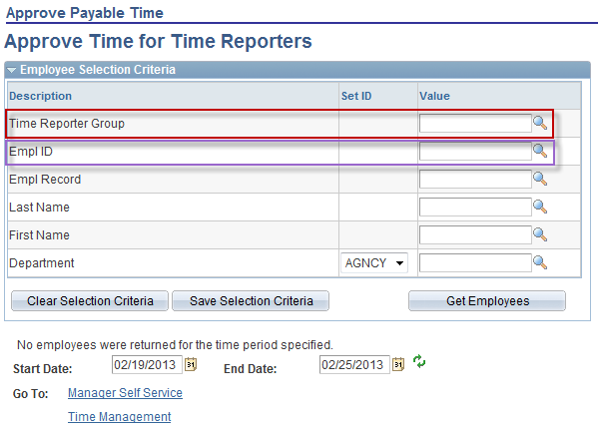
Approving Time
Time that needs approval can be searched by any of the criteria below. The most common criteria used are “Time Reporter Group” and “Empl ID”
Time Reporter Group will return a group of employees
“Empl ID” will return time for one employee per search
Notes:
Information:
1. You can use any of the fields to narrow down your search, such as Group ID for an entire group assigned to you, or just one employee, by either their EMPLID or Name.
Instructions:
Enter Group: 12345.
Next Screen:
Approve Payable Time Summary – Dates

Slide 14
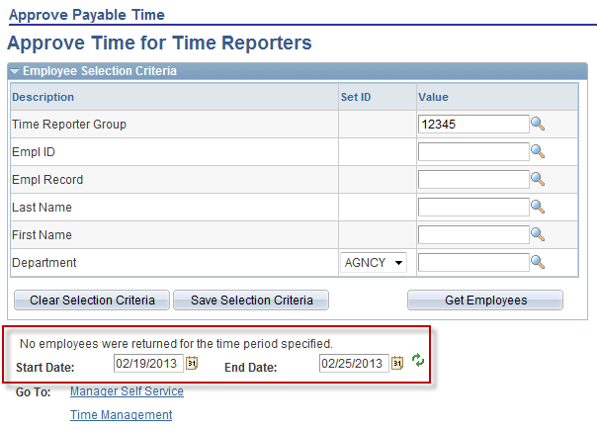
Approving Time
The End Date defaults to today’s date. The Start Date defaults as one week before the End Date.
Start Date and End Date: You can leave these fields blank to pull up all entries awaiting approval (includes other Pay Periods).
Start Date and End Date: You can enter just the Start Date to pull up all entries that need to be approved since that date.
Start Date and End Date: You can enter just the End Date to pull up all entries that need to be approved before that date..
Enter the start and end date of pay period you are approving time for
Notes:
Information:
The End Date defaults to today’s date. The Start Date defaults as one week before the End Date.
Start Date and End Date: You can leave these fields blank to pull up all entries awaiting approval (includes other Pay Periods).
Start Date and End Date: You can enter just the Start Date to pull up all entries that need to be approved since that date.
Start Date and End Date: You can enter just the End Date to pull up all entries that need to be approved before that date.
Instructions:
Enter the Start Date and End Date of the current pay period.
Next Screen:
Get Employees

Slide 15
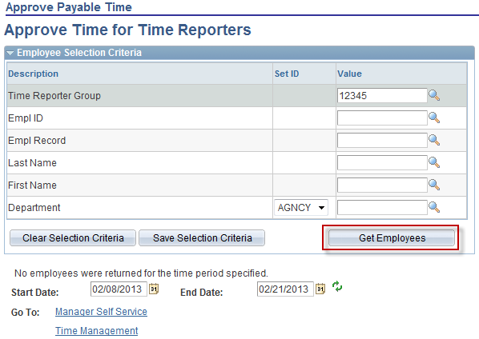
Approving Time
Once search criteria and dates are entered click on “Get Employees” button
Notes:
Information:
None at this time
Instructions:
Click Get Employees button.
Next Screen:
Warning Message

Slide 16
Approving Time
This warning will appear if an employee has entered time for a period prior to the current pay period. The employee ID number will be listed in the message.
Click OK to continue.
Notes:
Information:
If there is time prior to the start date selected needing approval a warning message will appear with the employee number.
To see that time click OK, delete the Start Date and click Get Employees.
All time needing approval will display.
Instructions:
Name: Click OK.
Next Screen:
Name link

Slide 17
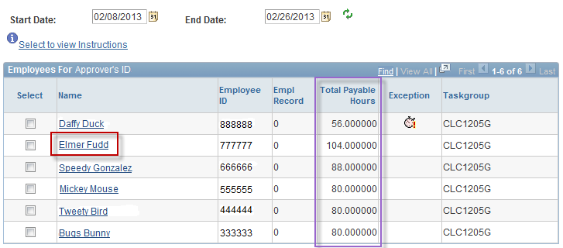
Approving Time
All employees in the Group selected having time that needs approval are displayed.
The Total Payable Hours ready for approval populates on this summary page
Alarm clock icon indicates there is an exception or error with time entered.
Clicking on employees name will take you to their individual time detail.
Notes:
Information:
All employees in the Group selected having time that needs approval are displayed.
The Total Payable Hours ready for approval populates on this summary page.
Instructions:
Name: Click the Elmer Fudd link.
Next Screen:
Approval Details page

Slide 18
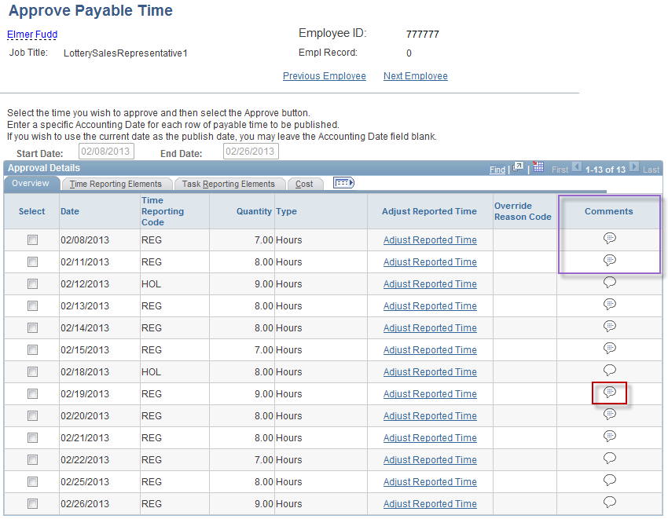
Approving Time
Once an employees name is clicked the system will list hours that need approval for that employee for chosen date range.
Shaded comments icons indicate a comment was entered by employee
Click on shaded icon to view comment
Notes:
Information:
Comments: You can view and/or enter new or additional comments.
Shaded Comments icon: Comments entered and saved.
White Comments icon: No comment entered.
Instructions:
Click Comments’ icon for 2/19/13 REG row.
Next Screen:
Comments

Slide 19
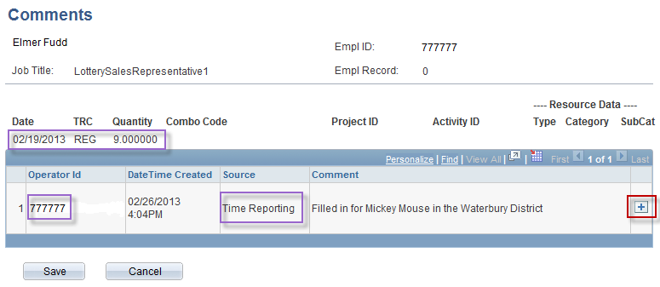
Approving Time
Click on “+” button to add a. comment of your own
After comment icon is clicked the system will display comment associated with those hours, as well as who entered the comment, when it was entered and where.
Notes:
Information:
The comment displays the Date, TRC and Quantity the comment was entered for.
The Operator ID shows who entered the comment.
The Source shows what page the comment was entered on (Timesheet, Approval, Adjust Paid Time).
The Plus button (+) is used to enter additional comments (up to 32,000 characters per row).
Instructions:
Read the Comments.
Click Plus button (+) to add an additional comment.
Next Screen:
Comments

Slide 20
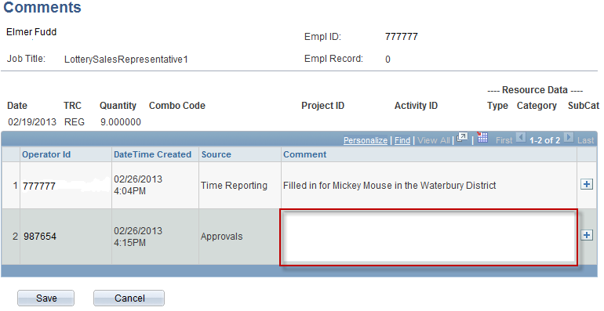
Approving Time
After clicking the “+” button a second comment box will appear with “approvals” as the source, and your comments here.
Notes:
Information:
None
Instructions:
Enter new Comment.
Next Screen:
Comments

Slide 21
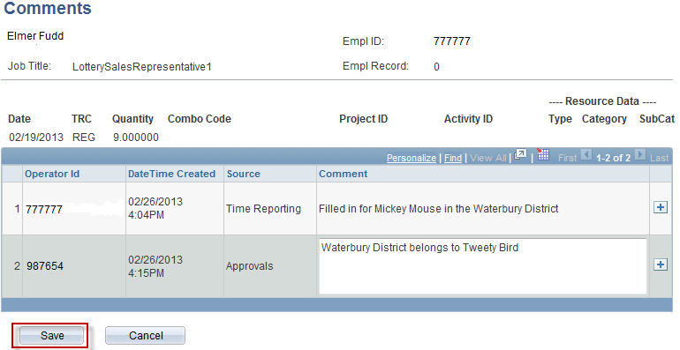
Approving Time
Once comment is entered click the save button to permanently save comment.
Notes:
Information:
None
Instructions:
Click Save.
Next Screen:
Comments Confirmation Warning

Slide 22
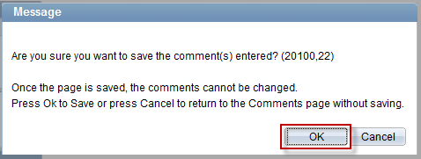
Approving Time
Message appears warning you that once saved the comment cannot be changed appears.
Click the OK button to permanently save the comment.
Notes:
Information:
Confirmation warning.
Click OK to save comments you enter.
Click Cancel to return to comments page without saving.
Instructions:
Click OK.
Next Screen:
Comments

Slide 23
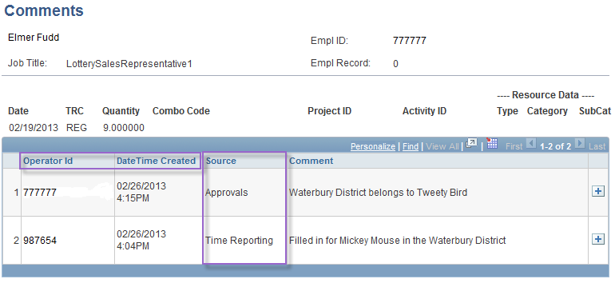
Approving Time
Comment has been permanently saved.
Click “Cancel” button to return to the Approval Page
Notes:
Information:
Comments saved.
Operator ID of person who entered comment.
Date/Time comment was saved.
Source indicates on what page comment was entered – Time Reporting (Timesheet), Approvals (Approval page), or Adjust Paid Time (only HR/Payroll has access).
Instructions:
1. Click Cancel to go back to the Approval page.
Next Screen:
Approval Details page

Slide 24
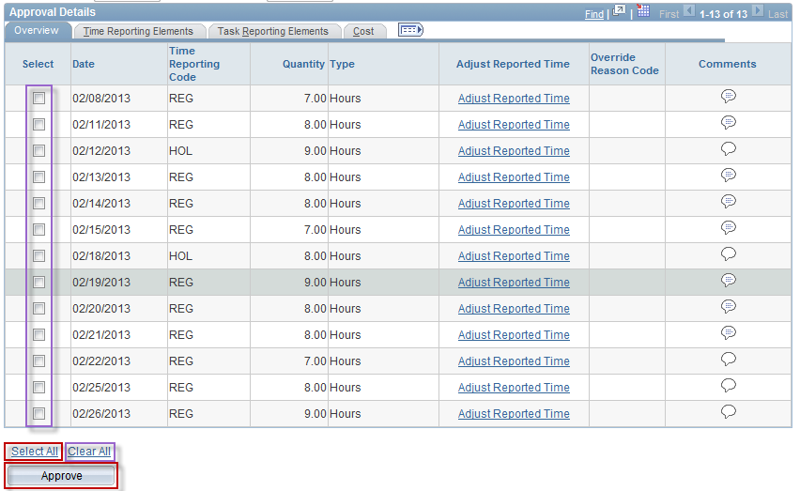
Approving Time
To approve the time, you can click the Select box for each row of attendance you wish to approve.
You can also click the Select All link to select all rows
Once rows are selected you can click the Clear All link to clear all selected rows.
Instructions:
Select All: Click this link to select all attendance rows.
Click Approve
You can also click the Select All link to select all rows
Once rows are selected you can click the Clear All link to clear all selected rows.
Click the “Approve” button to approve all time selected.
Notes:
Information:
To approve the time, you can click the Select box for each row of attendance you wish to approve.
You can also click the Select All link to select all rows.
Once rows are selected you can click the Clear All link to clear all selected rows.
Instructions:
Select All: Click this link to select all attendance rows.
Click Approve.
Next Screen:
Confirmation

Slide 25
Approving Time
System will warn approver that once time is approved the status cannot be changed.
Click the “Yes” button to permanently approve time.
Notes:
Information:
Click Yes to approve all checked entries.
After you click this OK button, you can not ‘unapprove time’; you must return to the Timesheet to delete or update any entry.
Updated Timesheet entries must reprocess through Time Admin before they appear on the Approve Payable Time page.
Deleted Timesheet entries must reprocess through Time Admin again before they disappear from the Approve Payable Time page.
Click No to return to the Approve Payable Time page without approving the selected entries.
Instructions:
Click the Yes button.
Next Screen:
Save Confirmation message

Slide 26
Approving Time
Click “OK” to complete approval process.
Notes:
Information:
This is only a confirmation page; you can not return to the previous
Approve Payable Time page at this point.
Instructions:
Click the OK button.
Next Screen:
Approve Details

Slide 27
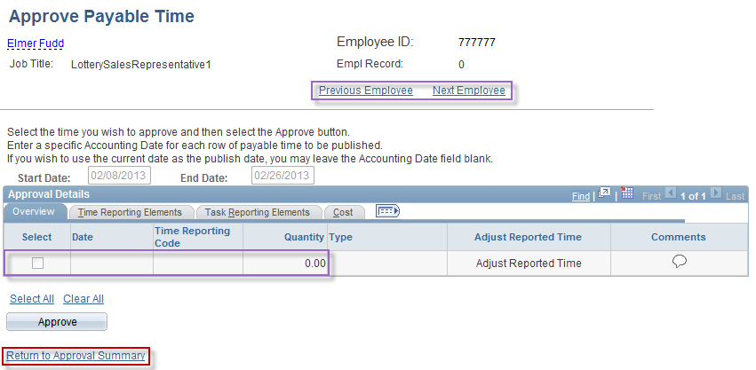
Approving Time
Click the Next Employee button to approve time for the next employee in your group.
All time has been approved for this employee in the time period selected
Click the Return to Approval Summary link to return to the Summary page.
Notes:
Information:
All time has been approved for this employee in the period selected.
Click the Next Employee button to approve time for the next employee in your group.
Click the Return to Approval Summary link to return to the Summary page.
Instructions:
Return to Approval Summary : Click this link.
Next Screen:
Approval Summary

Slide 28
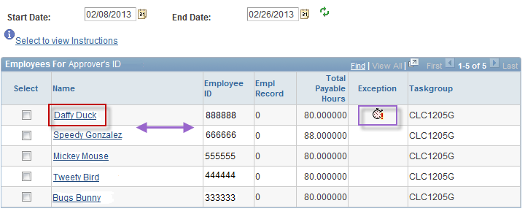
Approving Time
Elmer Fudd is not longer on list as his time has been approved.
Alarm clock icon indicates there is an exception or error with time submitted.
Click on employees name to begin researching the exception.
Click on employees name to begin researching the exception.
Notes:
Information:
Elmer Fudd no longer appears in the list of employees.
The Total Payable Hours displays the number of hours the employee has ready for approval for the time period selected.
Alarm Clock icon indicates there are Exceptions for the employee’s time.
Click the link for the next employee whose time you want to approve.
Instructions:
Name: Click the Daffy Duck link.
Next Screen:
Approval Detail

Slide 29
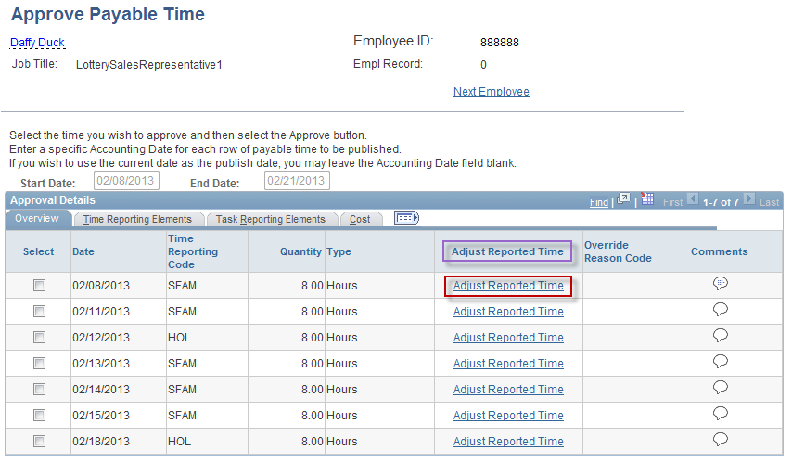
Approving Time
Click on the “Adjust Reported Time” Link to go to timesheet.
Notes:
Information:
Adjust Reported Time: This link allows you to view or update entries on the Timesheet.
Go to the Timesheet to view Exception details.
Instructions:
Adjust Reported Time: Click this link on the 2/8/13 row.
Next Screen:
Timesheet

Slide 30
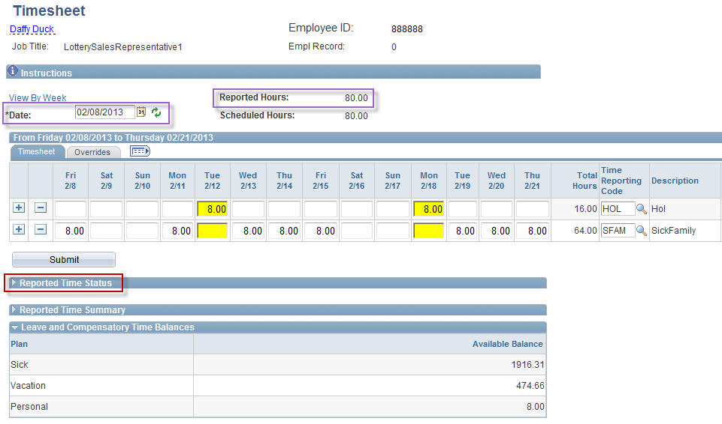
Approving Time (Adjust Reported Time link)
Click on the “Report Time Status” Link to check for exceptions/errors.
Notes:
Information:
You can use the Date field to view other Timesheet periods.
You can verify whether or not the Timesheet has been submitted by looking at the Reported Hours total.
You can check for exceptions by clicking on the Reported Time Status link.
Instructions:
Click on the Reported Time Status link.
Next Screen:
Reported Time Status link

Slide 31
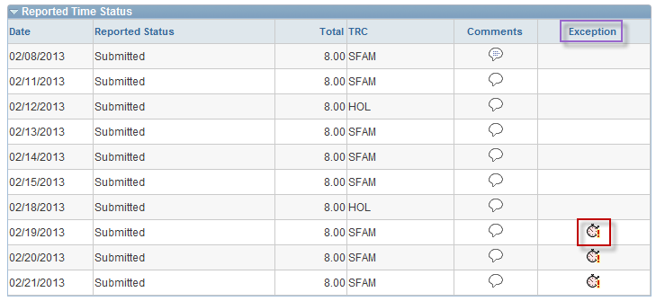
Approving Time (Adjust Reported Time link)
Alarm icons indicate exceptions or errors in time reported. In this case employee has gone over the allotted 5 sick family days per year.
For assistance researching exceptions contact the Payroll Department.
Notes:
Information:
If an exception exists for the employee the Exception column will display and there will be an alarm clock icon on the row.
Click on the alarm clock to see details about the exception.
Instructions:
Exception: Click the Alarm Clock icon on the 2/19/13 row.
Next Screen:
Exception Details

Slide 32
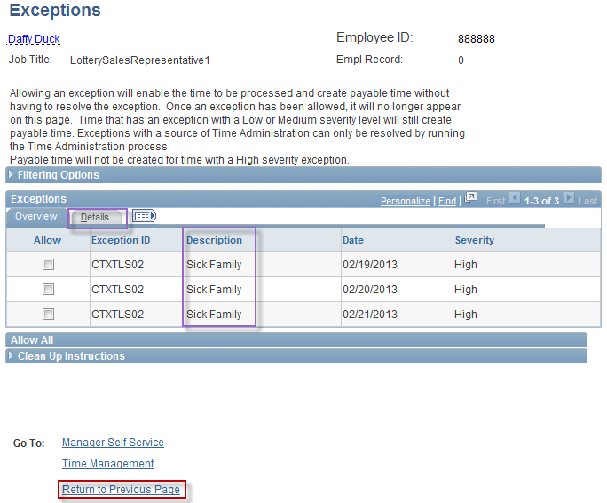
Approving Time (Adjust Reported Time link)
After clicking the alarm clock icon the system will bring you to the Exceptions page where all exceptions are listed and severity level noted.
Click “Return to Previous Page “ link to return to the timesheet.
Notes:
Information:
The Exceptions page will tell you what caused the exception.
The Details tab will explain possible solutions.
Instructions:
1. Click the Return to Previous Page link.
Next Screen:
Timesheet

Slide 33
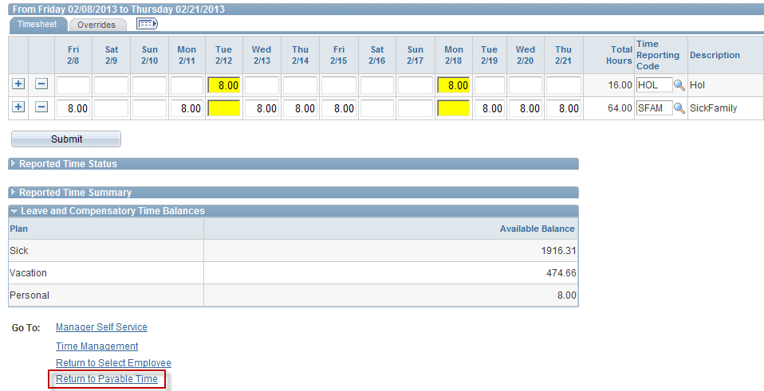
Approving Time (Adjust Reported Time link)
Clear exception by adding a row and changing reported time on timesheet using a different reporting code (VAC – vacation or PL – Personal Leave).
Click submit to save changes.
Exceptions will clear overnight and time will be ready for approval the following day.
Click on “Return to Payable Time” link to continue approving time
Notes:
Information:
Change the attendance causing the Exception.
The Exception will clear overnight during Time Administration and the changes will be ready for approval.
Payable Time for the rest of the pay period can be approved now or you can wait until Time Administration has processed the changes and approve all Payable Time at once.
Instructions:
Return to Approval Details: Click this link to return to the Approve Payable Time page you were on.
Next Screen:
Approve Payable Time - Detail

Slide 34
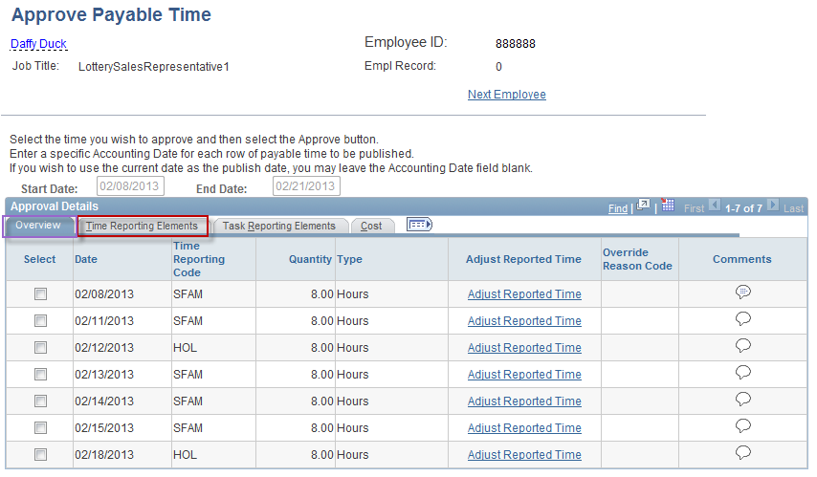
Approving Time
Recap of Overview Tab:
You can view the Date, Time Reporting Code, Override Reason Code, and Quantity on this tab.
You can enter Comments from this tab.
You can look at the employee’s Timesheet and make changes to it.
Notes:
Information:
Overview tab: As we’ve seen, you can view the Date, Time Reporting Code, Override Reason Code, and Quantity on this tab.
You can enter Comments from this tab.
You can look at the employee’s Timesheet and make changes to it.
Instructions:
1. Click the Time Reporting Elements tab.
Next Screen:
Time Reporting Elements - Override Rate

Slide 35
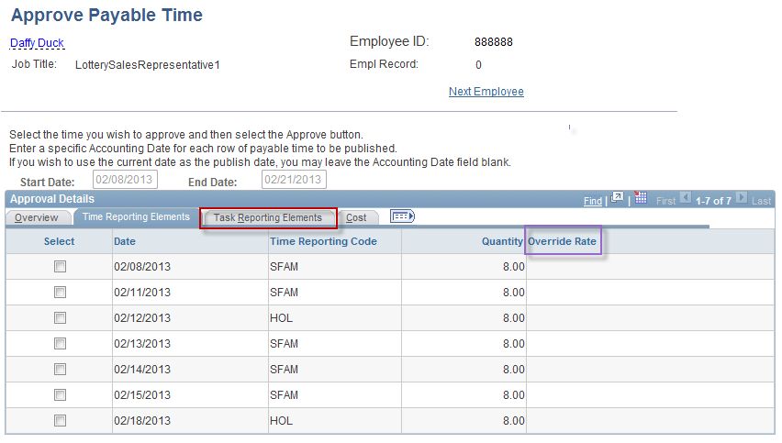
Approving Time
You can verify that a Override Rate was not mistakenly entered or that one was correctly entered.
This field is an override to the employee’s regular hourly rate.
This field is populated by the system when an employee has overtime or unpaid time during the pay period.
Notes:
Information:
You can verify that a Override Rate was not mistakenly entered or that one was correctly entered. This field is an override to the employee’s regular hourly rate. This field is populated by the system when an employee has overtime or unpaid time during the pay period.
You can approve from this tab.
Instructions:
Click the Task Reporting Elements tab.
Next Screen:
Task Reporting Elements – Claim Number, Combo Code, Chartfields

Slide 36
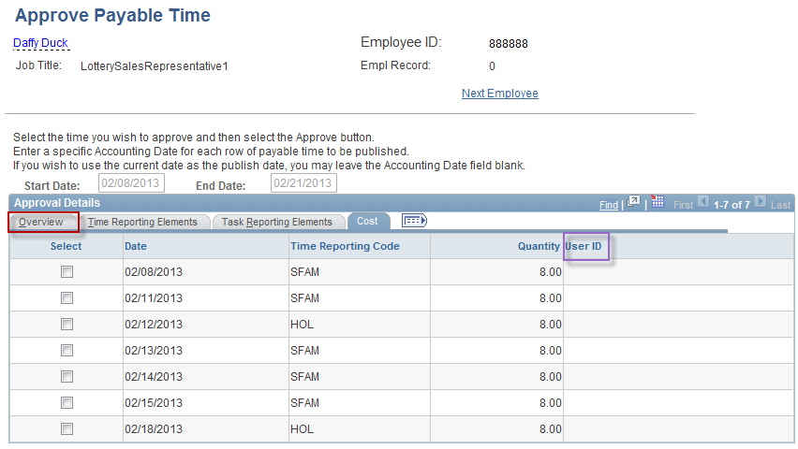
Approving Time
User ID field will populate once time has been approved.
Notes:
Information:
UserID is not populated until the time is approved.
You can approve from this tab.
Instructions:
Return to the Overview tab.
Next Screen:
Approve Time

Slide 37
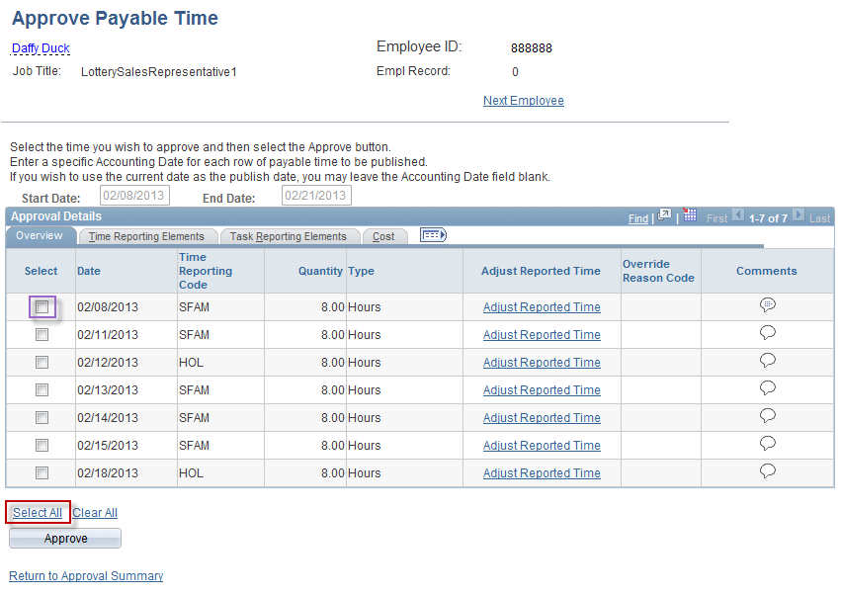
Approving Time
You can approve time from any tab
Select All: You can approve all rows at once
Individual check boxes: You can select as few as one row to approve
Leave any row unchecked to leave it as “Needs Approval”
Notes:
Information:
You can approve time from any tab.
Select All: You can approve all rows at once.
Individual checkboxes: You can select as few as one row to approve.
Leave any row unchecked to leave it as Needs Approval.
Instructions:
1. Click the Select All checkbox.
Next Screen:
Select All (selected)

Slide 38
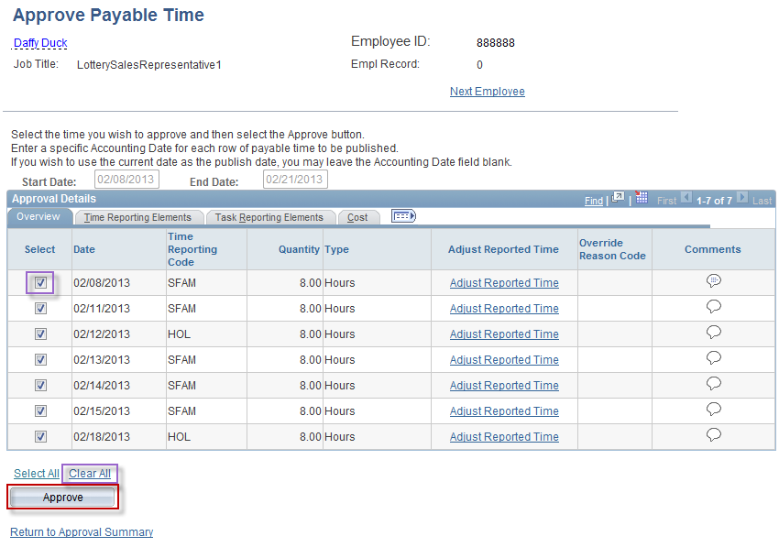
Approving Time
Once the hours you want approved are checked click the “Approve” button.
Notes:
Information:
Clear All: Click this checkbox to uncheck all of the selected boxes.
Uncheck individual checkboxes to not approve that time.
Instructions:
Click the Approve button.
Next Screen:
Approval Confirmation Warning

Slide 39
Approving Time
System will warn approver that once time is approved it cannot be unapproved. The only way to change approved time is to change the timesheet and approve the changes made.
Click the “Yes” button to continue.
Notes:
Information:
Click Yes to approve all checked entries.
After you click this Yes button, you can not ‘unapprove time’; you must return to the Timesheet to delete or update any entry.
Updated Timesheet entries must reprocess through Time Admin before they appear on the Approve Payable Time page.
Deleted Timesheet entries must reprocess through Time Admin again before they disappear from the Approve Payable Time page.
Click No to return to the Approve Payable Time page without approving the selected entries.
Instructions:
Click the Yes button.
Next Screen:
Save Confirmation message

Slide 40
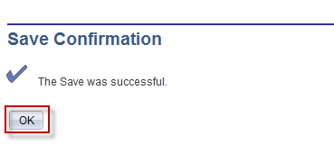
Approving Time
Core-CT will provide a save confirmation.
Click the “OK” button to continue.
Notes:
Information:
This is only a confirmation page; you can not return to the previous
Approve Payable Time page at this point.
Instructions:
Click the OK button.
Next Screen:
Approve Details

Slide 41
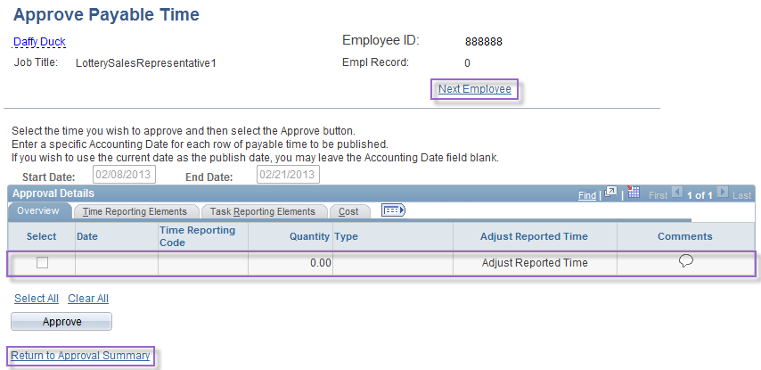
Approving Time
At this time you can either
Click on the “Next Employee” link or
Click on the “Return to Approval Summary” link
System will bring you back to employees “Approve Payable Time” screen.
In this case there is no more time that needs approval for Daffy Duck
Notes:
Information:
No time appears for this employee.
Click Return to Approval Summary link or Next Employee link to approve additional employees in your group.
Next Screen:
Review

Slide 42
Review - Supervisor – Approve Time
When approving Time, remember the following:
Time associated to an exception is not available for approval until the exception is cleared (access the Timesheet to view and correct Exceptions)
If one portion of Time entered generates an error, all time entered on that day is in error. When the Exception is corrected, the entire day is corrected
Once Time is approved, its status changes to Approved-Ready for Payroll
Time cannot be unapproved but it can be changed on the Timesheet
If Time is updated, it must reprocess through Time Admin before you can approve it
If Time is not approved (including changes), then those entries will not be sent to payroll
Notes:
Next Screen:
Knowledge Check

Slide 43
Knowledge Check - Supervisor – Approve Time
Answer the following questions:
How can a supervisor locate an exception?
a. Click the “Adjust Reported Time” link
b. Look for the alarm clock icon on the Approval Summary page
What happens if the supervisor does not approve time for an employee?
Nothing; unapproved time is not collected by the Payroll module. An employee will not be paid for unapproved time.
Whose time can a supervisor approve?
Employees in the Time and Labor Group(s) assigned to him or her
How does a supervisor unapprove time?
Delete the entry from the Timesheet (Remember that new or replacement time entries must go through the Time Admin process before being approved.)
Notes:
Information:
1a. Adjust Reported Time: Click this link to view timesheet entries, (you can change time, read comments, locate exceptions, etc.).
b. An alarm clock icon appears on the Approval Summary page.
2. Nothing, it does not go to Payroll. Time remains on Approval page until approved. Employee will not be paid for time that is unapproved.
3. Employee (s) in their group.
4. Timesheet: Delete entry from Timesheet.
Special Note:
To approve updated time:
A. Make replacement entry on Timesheet.
B. Wait for Time Admin process to run.
C. Return to Approve Time page (next day).
D. Approve updated entry (s).
Next Screen:
Agenda

Slide 44
Class Agenda – Supervisor Session
Welcome to the Time and Labor Supervisor Self Service Course!
Supervisor - Approve Time
Supervisor – Run Reports
Conclusion
UPK Practice Session (Optional)
Notes:
Next Screen:
Overview

Slide 45
Overview - Supervisor – Run Reports
Time & Labor reports can assist you in being proactive and in identifying issues.
The Run Control ID is the name of your Report, i.e. TRCUsageSFAM
Once a Run Control ID is saved, it can be reused
You can run reports for all employees you have access to by choosing an individual employee, a group of employees or a department
The more specific your criteria, the more specific your results
Notes:
Next Screen:
Key Points

Slide 46
Key Points - Supervisor – Running Reports
When running reports, remember the following:
You can add a new report or run a previously saved report
You can adjust a previously saved report’s criteria to receive new information
Notes:
Next Screen:
Walk Through

Slide 47
Walk-through and Exercise - Supervisor – Run a Report
Step-by-Step Demonstration.
First, we will walk-through the process together
Scenario: Add and Run a TRC Usage Report
Notes:
SCENARIO:
Your director has asked for a report on Daffy Duck’s time for the pay period
11/16/12 – 11/29/12. You need to run a report to obtain this information.
Next Screen:
Navigation

Slide 48
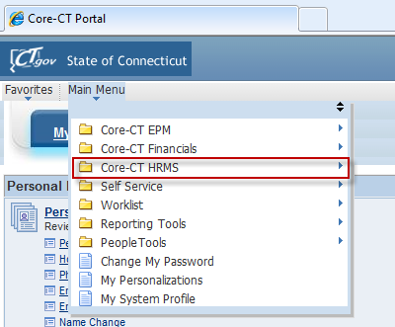
Navigation – Running a Report
Begin by clicking in the “Main Menu” Tab on the Core-CT homepage.
Next click on the “Core-CT HRMS” option
Notes:
Navigation:
Main Menu > Core-CT HRMS > Time and Labor > Reports > (select report)
Next Screen:
Navigation (cont.)

Slide 49
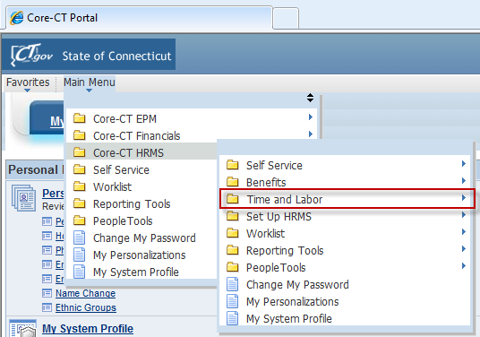
Navigation – Running a Report
Next click on the “Time and Labor” folder.
Notes:
Navigation:
Main Menu > Core-CT HRMS > Time and Labor > Reports > (select report)
Next Screen:
Navigation (cont.)

Slide 50
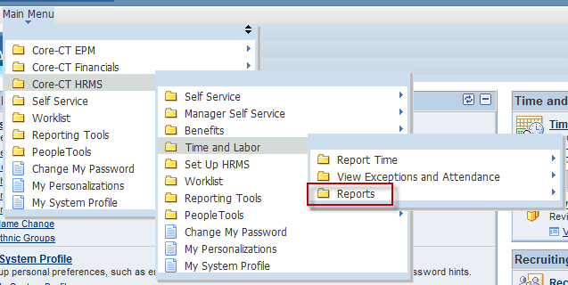
Navigation – Running a Report
Click on the “Reports” link.
Notes:
Navigation:
Main Menu > Core-CT HRMS > Time and Labor > Reports > (select report)
Next Screen:
Navigation (cont.)

Slide 51
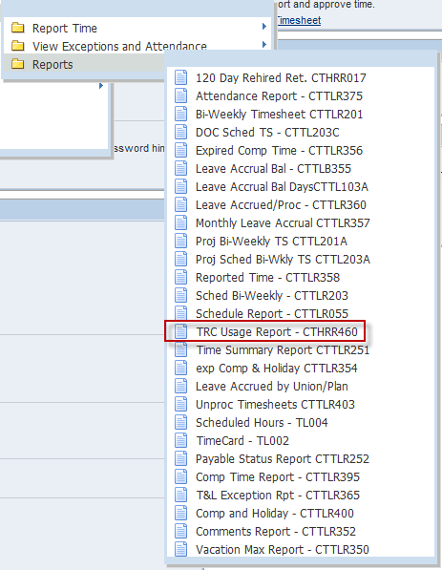
Navigation – Running a Report
Click on “TRC Usage Report” link.
Notes:
Navigation:
Main Menu > Core-CT HRMS > Time and Labor > Reports > (select report)
Instructions:
Click TRC Usage Report
Next Screen:
TRC Usage Report – Run Control

Slide 52
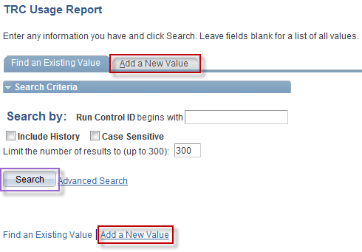
Running a Report
If you have already created a Run Control ID for this TRC Usage Report then click search and find the name of the report you would like to run.
If this is the first time you have run this TRC Usage Report click the “Add a New Value” link to add a new Run Control ID.
Notes:
Information:
This is the Run Control page. Run Control is the name of your report.
Find an Existing Value: Click Search to pull up any previously saved reports.
Add a New Value: If you have not previously run a report, use this tab to create a new one.
Instructions:
Click the Add a New Value tab.
Next Screen:
TRC Usage Report – Add a New Value

Slide 53
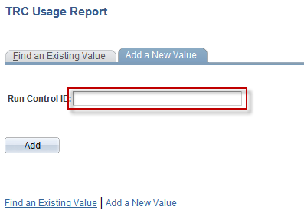
Running a Report
When adding a new Run Control ID click in the blank field and type in your report name.
When you have populated the Run Control ID with the new report name click the “Add” button.
Notes:
Information:
Run Control ID: This will be your report’s name, such as TRCUsageReport.
Instructions:
Type: TRCUsageReport.
Next Screen:
TRC Usage Report – Add button

Slide 54
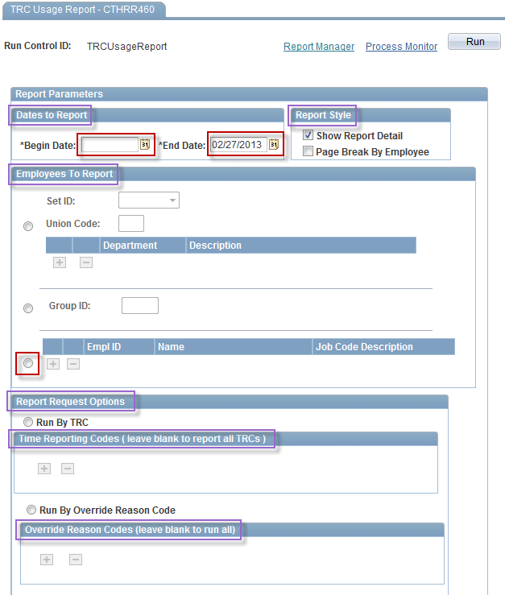
Running a Report
How to set up TRC Usage Report criteria:
Type a date range for the report to cover.
Choose a Report Style
Select “Employees To Report” criteria by
Union Code
Group ID
Individual Employees
Finally, choose TRC codes the report should return.
Notes:
Information:
Field parameters help to expand or limit searches.
You can run this report by any of the following:
A. Date range
B. Department, Group or Employee
C. TRC
D. Override Reason Code
3. You can choose to run the report with Details or by summary or have each employee printed to a separate page.
Instructions:
Enter the Begin Date: 11/16/12
Enter the End Date: 11/29/12
Click the Radio button for EmplID
Enter the EmplID: 888888
Next Screen:
TRC Usage Report – Begin and End Date

Slide 55
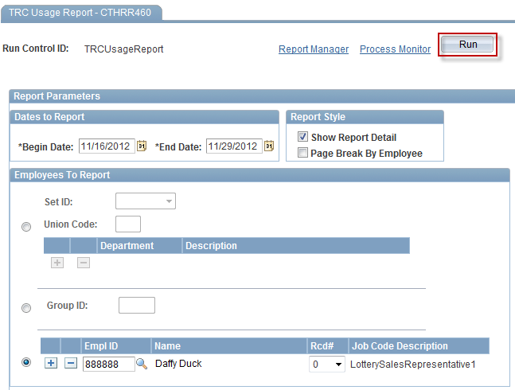
Running a Report
Once criteria is populated click the “Run” button.
Notes:
Information:
2. When you click Run, this report’s parameters are automatically saved.
Instructions:
Click the Run button.
Next Screen:
Process Scheduler Request

Slide 56
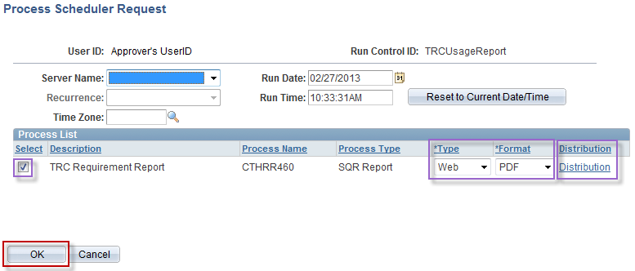
Running a Report
The system will bring you to a “Process Scheduler Request” page. The system would have prepopulated data on this page that should not be changed. On this page you will simply click the “OK” button to generate the report.
Notes:
Information:
The default parameters are displayed.
Change the default parameters as needed.
You can add a User ID to send this report to by clicking on the Distribution link.
Special Note:
The Server Name should not be changed.
Instructions:
Click the OK button.
Next Screen:
TRC Usage Report Search page

Slide 57
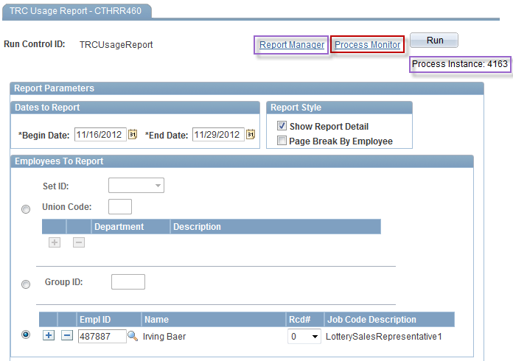
Running a Report
System will bring you back to the criteria page where a Process Instance number has been assigned to the report. This Process Instance number can be used to view the report again at a later date. Reports are stored in Core-CT for 30 days.
Click on the “Report Manager” Link.
888888
Daffy Duck
Notes:
Information:
Process Monitor: You can view the status of your report: Queued, Processing, Posted, No Success. Click the Refresh button until your report has been Posted.
Process Instance allows you to find the report again at a later date.
Report Manager: Click the Refresh button until your report link populates.
Instructions:
Click the Process Monitor link.
Next Screen:
Process Monitor (Report link)

Slide 58
Attendance Report
A Report may take up to two minutes to run
Periodically click the “Refresh” button until the report link appears below
TRC Usage Report
Once created the report will be listed on the Report Manager page.
Access report by clicking the Report link
Notes:
Information:
When the Report link generates (i.e., CTTLR375), your report is ready for you to view.
Instructions:
Click the Refresh button until the Name link populates.
Click the CTTLR375 link.
Next Screen:
Report (file link)

Slide 59
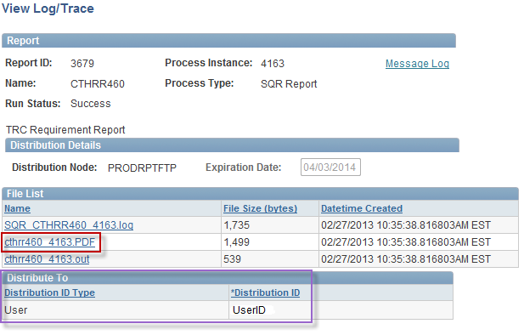
Running a Report
Click on the .PDF link listed.
Notes:
Information:
Look for the link that contains an extension with the format requested (i.e., .LIS or .PDF).
The UserIDs that can view the report are listed under Distribute To
Instructions:
Report: Click the cthrr460_4163.PDF link.
Next Screen:
TRC Requirement Report (results)

Slide 60
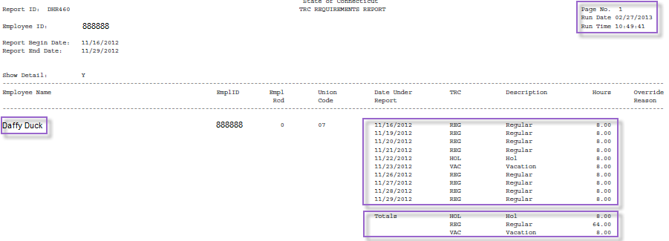
Running a Report
Report can be viewed, printed or saved from this screen.
Report can also be viewed in Core-CT for up to 30 days using the “Process Instance” ID number.
Notes:
Information:
You can print, save, and close this report with the options at the top of your screen.
The Page Number, Date and Time the report was run is displayed.
Employee Name and corresponding TRC info populated: 11/29/12 pay period.
Totals: Gives totals of hours per Employee/TRC.
Next Screen:
Review

Slide 61
Review - Supervisor – Running a Report
When running a report, remember the following:
You can search for an existing report or add a new one
When you run a report, its parameters are automatically saved
After you have run a report, you can save it, delete it, print it or toggle back and forth from it to other programs you are running on your computer
The more narrow your criteria, the more narrow your results
You can run a report for one employee or a group of employees
Reports are saved in Core for 30 days
Notes:
Next Screen:
Knowledge Check

Slide 62
Knowledge Check - Supervisor – Running a Report
Answer the following questions:
1. What is a Run Control ID?
Report Name
2. What search page tab do you click to create a new Run Control ID?
Add a New Value
3. Which link do you click to access the Reports page, Report Manager or Process Monitor?
Report Manager is the preferred one
4. Do you need to manually save your report if you click Run?
No
5. How long are reports available under Report Manager?
30 days. If you think you will need it longer, then you must save it to a local or network drive or print it.
Notes:
Information:
Report Name
Add a New Value
Report Manager is the preferred one
No
30 days. If you think you will need it longer than that you must save it to a local or network drive or print it.
Next Screen:
Agenda

Slide 63
Class Agenda – Supervisor Session
Welcome to the Time and Labor Supervisor Self Service Course!
Supervisor - Approve Time
Supervisor – Run Reports
Conclusion
UPK Practice Session (Optional)
Notes:
Next Screen:
Overall Key Points

Slide 64
Overall Key Points – Supervisor Self Service
Approving Time:
1. Time can not be unapproved 2. Time can be changed 3. Updated time must be reprocessed and approved
Running Reports: 1. Run Control ID: Report’s Name 2. Set up report once and reuse 3. Run reports by employee or group
Notes:
Next Screen:
Training Materials

Slide 65
Training Materials
Training materials for Time and Labor Employee Self Service:
Course Presentation
UPK Exercises are provided on your:
CORE-CT home page under Core-CT Help tab
Job Aids are provided on your:
SCSU Payroll Department web page
Notes:
Next Screen:
Recommended Job Aids

Slide 66
UPK Exercises Practice Session
In the UPK exercises, you will have the ability to:
Watch a step-by-step exercise play (See It!)
Perform an exercise in an interactive manner (Try It!, Know It!)
Notes:
Information:
UPK Exercise Types: A. See It! – user watches as computer displays steps B. Try It! – user performs steps with guided instructions
C. Know It? – user performs steps with limited instructions and can ask for instructions if stuck
D. Do It! – user performs steps with limited instructions
Instructions:
None
Next Screen:
Navigate to UPK Exercises

Slide 67
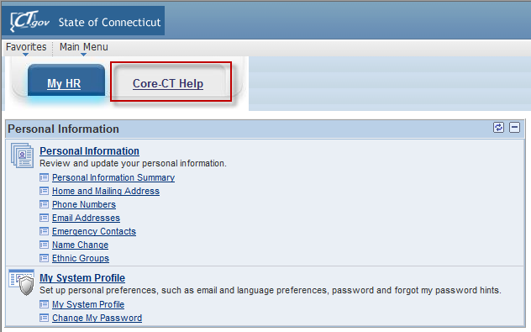
UPK Exercises Practice Session
Click on the “Core-CT Help” tab on the Core-CT homepage.
Notes:
Information:
1. The UPK exercises are available from Core-CT under the Core-CT Help tab.
Instructions:
Click the Core-CT Help tab.
Next Screen:
UPK Exercises links

Slide 68
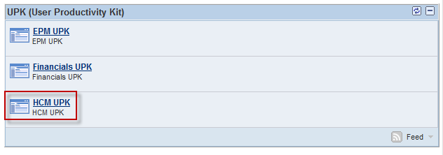
UPK Exercises Practice Session
Click on the “HCM UPK” link
Notes:
Information:
1. The UPK exercises are listed by module: EPM, Financials and HRMS.
Instructions:
Click the HCM UPK Exercises link.
Next Screen:
Choose Exercise

Slide 69
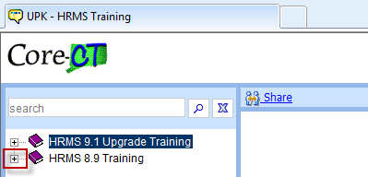
UPK Exercises Practice Session
Click on the “+” for “HRMS 8.9 Training”
Notes:
Information:
A new window opens with the exercise folders.
Instructions:
Click the HRMS 8.9 Training folder
Next Screen:
Choose Exercise

Slide 70
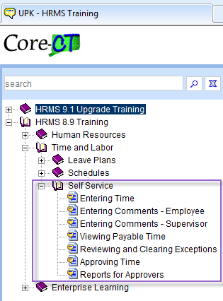
UPK Exercises Practice Session
Choose which UPK you would like to review by clicking on it’s name.
Notes:
Information:
A new window opens
Instructions:
Click the exercise you would like to view.
Click the See It! mode.
The exercise will load.
Next Screen:
Questions?

Slide 71
Questions
Questions?
Payroll Department
Beata Winiarski - Payroll Coordinator - (203) 392-5425
Ken Pereira - Payroll Officer - (203) 392-5427
Kommaly Xayasone – Payroll Clerk- (203) 392-5079
Linda D'Addio - Payroll Clerk - (203) 392-5621
Notes:
Information:
Perform exercises as desired.
Encourage them to ask for assistance if needed.
Instructions:
1. Stroll around room and assist users as needed.
Next Screen:
None – End of presentation

