Slide 1
NEWSLETTER
Department of World Languages and Literatures
Number 9, Newsletter 2017-2018

Slide 2
CHAIR’S REMARKS
It is always an enormous pleasure to write the remarks for the Department’s annual newsletter. Every year I have served as chairperson of the Department is characterized by different challenges, projects and opportunities. This year was exceptional in many ways, but mostly in the area of major shifts with our human resources. The Department experienced a year of significant transition in filling vacant or temporary positions. Indeed, much of the year was spent stabilizing the Department, as we hired new colleagues and redeployed some of our current faculty members where there was a critical need. Dr. Elu Tu, who has been doing spectacular work directing our language labs for the last year and a half, was hired to join the Department on the tenure-track. Dr. Tu has transformed our lab in the short time she has already been with us, and I believe I can speak for the entire Department in expressing our excitement about the energy and vision Elu brings to the Department. On a less happy note, our cherished coordinator of World Language Teacher Certification and German, Dr. Chrisitine Dombrowski, resigned last summer due to medical reasons. We wish her well in this new phase of her life. After a rough transition semester, Dr. Jesse Gleason (TESOL and Spanish) stepped in to take over the position of Teacher Certification coordinator in the spring 2018 semester.

Slide 3
Jesse has already made significant progress getting the program back on its feet. We are excited to welcome Sophia Diamantis, will join the Department as a Visiting Assistant Professor of TESOL in the fall. While she grew up locally and has delivered TESOL and Spanish courses in the Department in the past, Sophia is currently completing her doctorate from the University of Wisconsin, Madison. We look forward to welcoming Sophia back to campus in the coming year. Finally, the Department was fortunate to hire Jessica Reynolds as the new Department Secretary. While she has only been in the position for a few months, Jessica has already proven herself to be invaluable to the Department. Our former secretary who was with us for well over a decade, Denina Harris, is now the secretary of the Chemistry Department. Thank you, Nina, for your years of service. While the last year has been a time of enormous change of staff and faculty within the Department, we are thrilled to have filled every one of our vacancies with energetic, passionate and highly qualified colleagues. I have no doubt that these changes will significantly improve our Department for many years to come.
Members of our community have also had noteworthy successes this year that must be mentioned in these remarks. Dr. Luke Eilderts and Dr. Miaowei Weng were both granted tenure and promoted to Associate Professor. In addition, both of them received semester-long sabbatical leaves, which they will take in the 2018-19 year, Luke in the Fall and Miaowei in the Spring. I also want to congratulate Dr. Lisa Vitale, who will begin next year in a new role as Assistant to the Deans of Arts and Sciences, and Dr. Sobeira Latorre for being reappointed to the position of Director of Interdisciplinary Studies. I have also been reelected to serve a second term as Department Chairperson.

Slide 4
In the coming year, there will also be a number of significant changes in coordinator roles. I wish to thank our outgoing coordinators for their strong commitment to the Department and the University: Luisa Piemontese (Spanish Section and Curriculum Coordinator) and Dr. Miaowei Weng (MA in Romance Languages Coordinator). Dr. Miaowei Weng will begin serving as the Spanish Section Coordinator; Dr. William Flores will take on the role of Spanish Curriculum Coordinator; and Dr. Rafael Hernández will assume the position of MA in Romance Languages Coordinator in the Spring 2019 semester. Thank you all for your past and future service to the Department.
We are also thrilled to honor our outstanding students this year who received University and Department awards and scholarships. Kanita Mote received the University’s most prestigious award—the Barnard Award—as well as the Constance Cryer Ecklund Award for Excellence in French; Deanna Scotto received the Academic Excellence in Italian Award and Departmental Honors in World Languages and Literatures; Abner Yanes received the Academic Excellence in Spanish award; and Mary Elizabeth Griesbacker received the German Book Award. We were fortunate to be able to award our students a large number of scholarships this year; among next year’s awardees are: María Beltran, Kamaya Bilheimer, Miguel Díaz, Tatiana Lorenzo, Heidi Matias, Kalyrin Rivera, Marisol Rivera, Gabriela Vazquez, Matthew Torrisi, Regina Roper, David Difabio, and Shannon Reed.

Slide 5
All of our student clubs were active this year, organizing conversation tables, charity events, get-togethers, workshops, film screenings and field trips. Thank you to our student leaders and faculty sponsors for all they do to enrich student life through participation in clubs. These activities are such an important part of the experience of majors and minors.
As we anticipate the fall 2018 semester, I extend my congratulations to all of our graduating seniors and Master’s degree students. In addition, I wish our three study abroad directors—Carlos Arboleda, Luke Eilderts and Pina Palma—well wishes as they embark on their journeys to Spain, France and Italy respectively.
Dr. Resha Cardone, Chairperson
Department of World Languages and Literatures

Slide 6
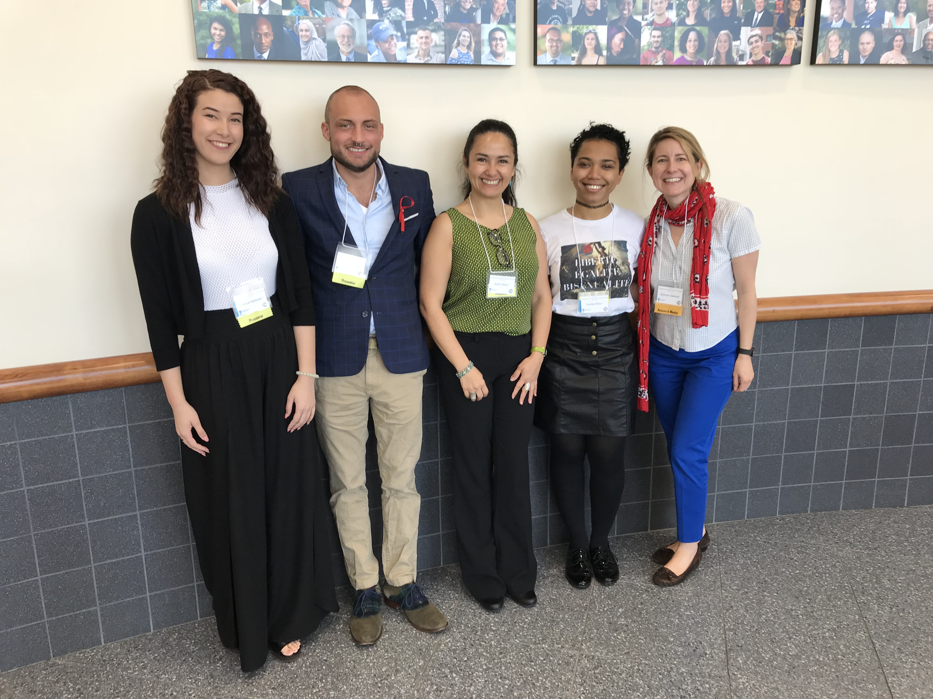
French Section
This year the French section celebrated the accomplishments of several students. At the graduate level, Judith Doherty received her M.A. in Romance Languages with a concentration in French after completing her special project entitled “Nineteenth-Century French Art and Poetry: Texts for Engagement with French Language.” Drs. Luke Eilderts and Nichole Gleisner were very impressed with her ability to enliven the study of French through her expertise in Art education. They look forward to experimenting with Judith’s materials in future courses. At the undergraduate level, Jessica Hartwell, Kanita Mote, and Zachary Walzer received their B.A. degrees in French as a part of the commencement ceremonies held in Bridgeport on May 18, 2018. We wish them the best of luck as they venture out into the world and encourage them to keep in touch.
Students enrolled in Dr. Nichole Gleisner’s course, FRE 470: Le Romantisme, all participated in the 2018 Undergraduate Research Day held on April 14, 2018. Several students presented individual presentations while others opted for the poster session. Each one of them demonstrated excellent research skills as they traced nineteenth-century notions of Romanticism in today’s popular culture. Bravo à toutes et à tous !
L to R: Jessica Hartwell, Zachary Walzer, Astrid Novo, Kanita Mote, Dr. Nichole Gleisner

Slide 7
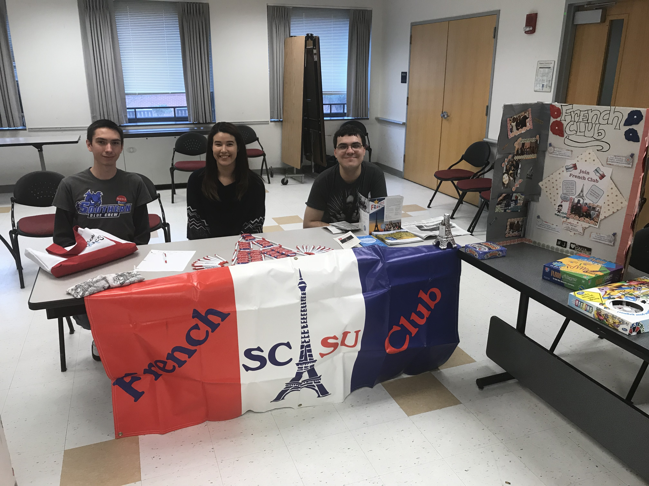
L to R: David Betters, Jessica Hartwell, Andrew Patenaude
The Cercle français (French Club) was as active as ever this year, even joining up with the other language clubs for field trips to sites in Connecticut. Executive committee members Jessica Hartwell (president), Sophia Whipple (vice-president), Andrew Patenaude (secretary), and Amanda Damon (treasurer) did a wonderful job planning weekly meetings, participating in university-wide events, and semester-end outings.

Slide 8
For the first time ever, the French section collaborated with Professor Alex Girard and his students in ART 415: Professional Practice in Graphic Design. Students were charged with creating logos and materials for the French Studies program and the Cercle français. The top four designers were Kathryn Fellmeth, Joshua Connor, Madelaine O’Brien, and Jimmy Cohaguila. Félicitations! The final logos will be unveiled at the beginning of the 2018-2019 academic year.
Finally, a heartfelt thank you to all the part-time faculty in the French section: Dr. Connie Ecklund, Joe Flood, Dr. Nichole Gleisner, Cindi Kuzman, Moussa Ly, Olga Musacchio, and Andrea Ritter. Merci mille fois ‘
Dr. Luke L. Eilderts, Associate Professor of French Coordinator of the French Section

Slide 9
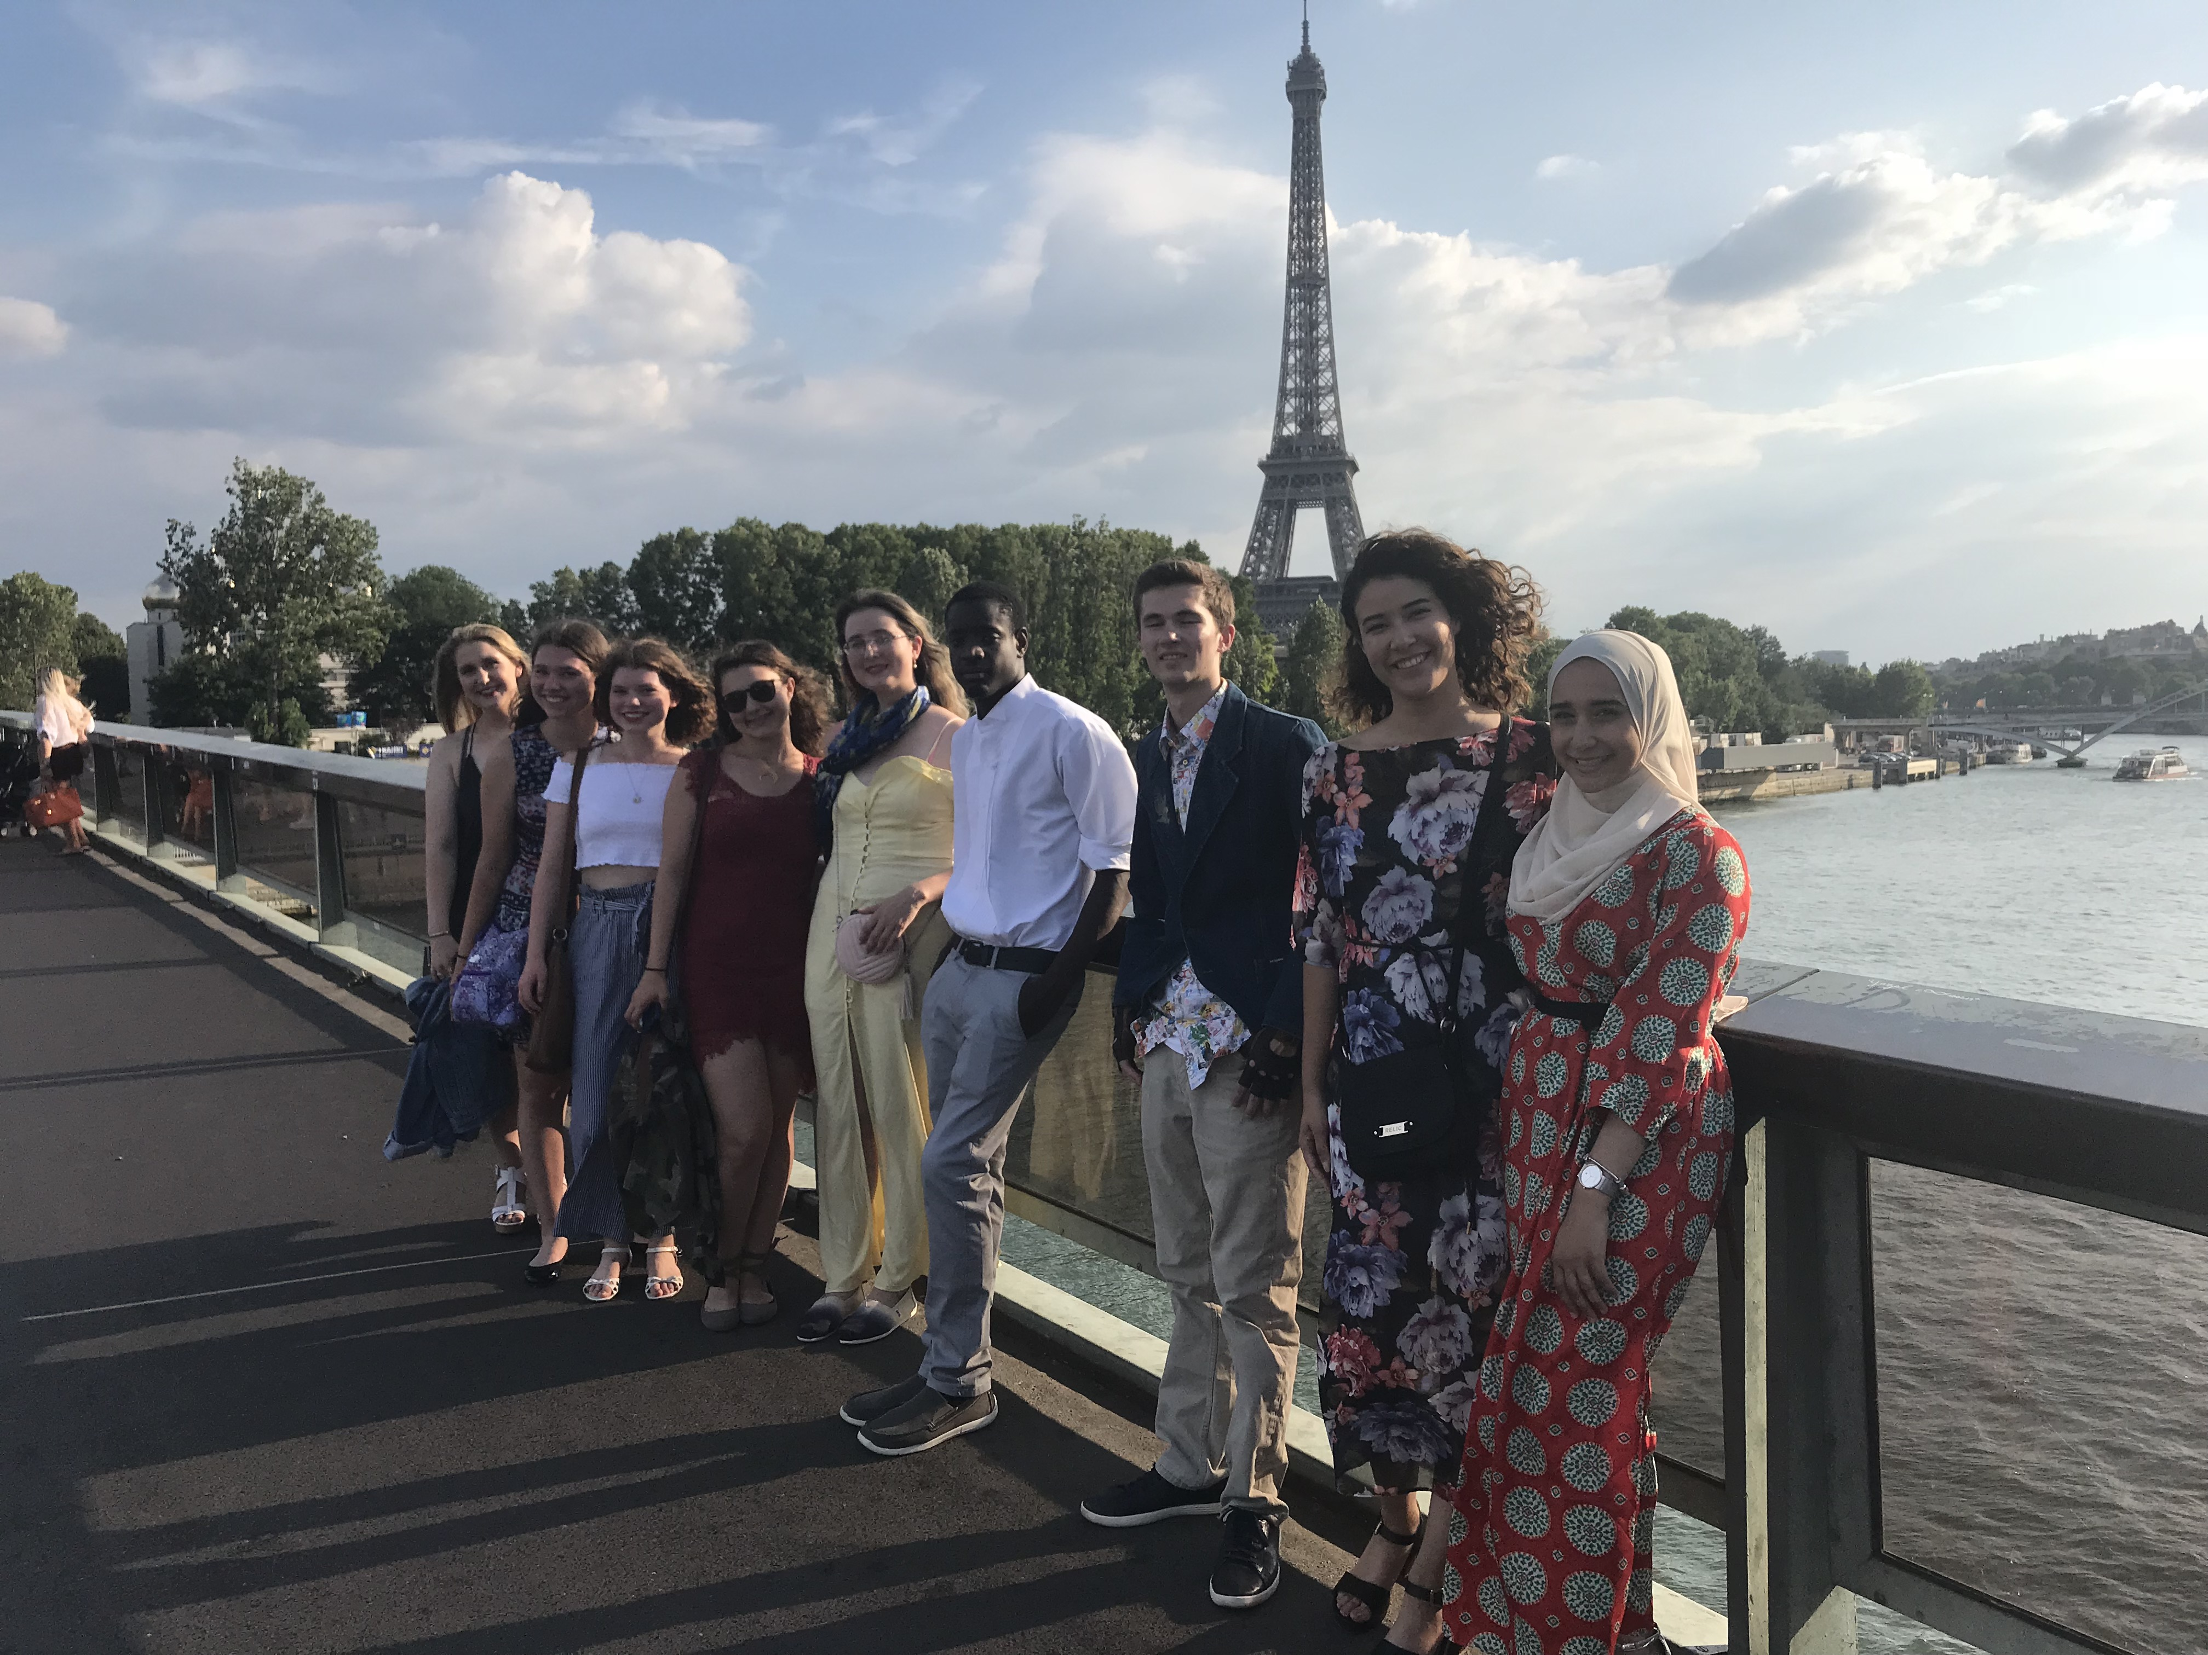
Southern in Paris 2018
L to R: Alexandra Takacs, Ally Morin-Viall, Madelon Morin-Viall, Lauren DeNomme, Jocelyn Marston, Trevon Homeward-Bennett, Joseph Warzel, Jessica Hartwell, Kulsoom Farid.
Nine students participated in the Southern in Paris 2018 program, which was co-directed by Drs. Camille Serchuk (Art) and Luke Eilderts (WLL). While improving their linguistic and cultural competencies, students also learned about the history of Paris through its art and architecture during the month of June. Students visited such celebrated sites as the Basilica of Saint-Denis, the castle of Vaux-le-Vicomte, the Palace of Versailles, the Garnier Opera house, and Monet’s gardens at Giverny. In addition to these one-time visits, students also discovered the treasures of the Louvre during our weekly evening gatherings, after which we would head out to dinner at one of the capital’s many fine restaurants. A life changing experience for many, study abroad continues to be one of the highlights of the French program at Southern.

Slide 10
Kanita Mote:
Kanita Mote has been a bright spot in the French section since her arrival on Southern’s campus. Dr. Eilderts recalls his first meeting with her, where he was thoroughly impressed with her language skills. In fact, Kanita spoke in French the entire time, from greetings and introductions to course selection and advising! While impressive even before her semester-long study abroad experience in Chambéry, France, her linguistic and cultural competencies in French soared during her time there. After her return to Southern, she continued to excel in every area. Indeed, few students have made such a lasting impression as Kanita has.
During her time at Southern, Kanita not only excelled in the classroom, but she also demonstrated a deep commitment to her community and profound belief in Social Justice. Uniting all these qualities along with her stellar academic performance earned her the distinction of being named a recipient of the Henry Barnard Distinguished Student Award, the highest honor a student at Southern can earn.
Kanita also received the first Award for Excellence in French, named in honor of Professor Emeritus Dr. Contance Cryer Ecklund, during the Honors Convocation ceremony held April 29, 2018. The award recognizes the student with the highest GPA in French. She is also a member of Pi Delta Phi, the National French Honor Society.
We in the French Section are so very proud of Kanita and her accomplishments. We wish her the very best as she navigates life after graduation. Félicitations!
Henry Barnard Distinguished Student Award

Slide 11
Italian Section
The Italian section just concluded a very active and stimulating academic year. We hosted two widely attended conferences. The first brought to campus Lori Ultsch (Hofstra U.) who spoke on Gender and Genre: Early Modern Women Writers of the Veneto. For the second conference Fred Kudojo Kuvornu, the award-winning Italian-Ghanian activist and movie director, presented screenings of his documentaries: 18 IUS SOLI and Inside Buffalo that examine issues of race, ethnicity, and national identity in the 21st century multicultural Italy. Kudojo Kuvornu’s screenings were followed by question and answer sessions during which students and faculty from across the campus discussed various aspects of the reception migrants receive and the discriminatory attitudes they are subjected to -- because they are perceived as “different” -- in the countries they reach after extremely treacherous journeys across the seas. The discourse on social justice, the underlining conference theme, stirred the audience and led to most vivid conversations across cultures, as well as, across Southern CT State University’s departments, and sections.

Slide 12
In October the Italian Section reached out to the wider CT Teacher Community by hosting a Serata Italian a gathering of CT Teachers of Italian. Teachers from every corner of the state convened to SCSU on the Green to discuss and organize didactic collaborations across school districts. The event was co-sponsored by CITA, the CT Organization for Teachers of Italian, with Sonia Beretta as a presenter and moderator.
The section reached out to the New Haven community with the help of Italianissimi, by hosting two Bocce Tournaments. The funds from both events, Bocce for Harvey and Bocce for Irma and Maria were given to Hurricane Relief funds. The tournaments combined our interest in community activism and cultural awareness. Both students and faculty participated in the fun that the Italian game provided and contributed to the collection of funds that benefited the communities hit by the hurricanes.
For the New Haven community, the Italian section also sponsored a genealogy workshop led by Laura Parisi, President of the CT Italian American Historical Society. A large representation of members from the Greater New Haven community desirous to discover their ancestral Italian roots attended the workshop.
For the younger members of the Greater New Haven Community, the Italian Section hosted students from Hamden High School. Led by their teacher Paula Rochniak, the group took part in a day of fun Italian cultural activities. Similarly, for Discovery Day, the section organized games with prizes for all visiting students and families. Southern’s students of Italian traveled to the Metropolitan Museum of Art in New York City to see Michelangelo: Divine Draftsman & Designer exhibit.

Slide 13
The Fifth Edition of Contemporary Italian Movies took place throughout the academic year. After the publicity that this event garnered last year, thanks in part to an article published in the Hartford Courant, people came to SCSU for the screenings of these movies from far away places. We look forward to continuing this activity in the next years.
All of these activities would be meaningless if they were not backed up by our students’ academic success. To this end, we congratulate those students who, with their original projects, participated in the Undergraduate Research Day and the Graduate Research Day.
Finally, it is with bitter-sweet joy that we say good-by to our major, Deanna Scotto, who graduated from the Honors College after defending her thesis on Italian-English code switching in Italo-American literary works. More importantly, Deanna was selected for the NIAF on Campus, a prestigious honor awarded by the NIAF Italian American Leadership Council Fellowship. Ad astra Deanna!!!
Our upcoming star-major, Nicholas Talarico, was awarded a competitive and prestigious paid internship to teach English in Italy during the 2018-2019 academic year with the “English for Everybody” Program. This program is a collaborative effort between a group of Italian schools in Brescia, Italy, and Oxford, Bath, and Cardiff Universities in England. As an English language assistant, Nick will work in the classroom and collaborate with the host-teacher in creating effective and meaningful lesson plans. Well done, Nick! We are proud of your work!
With this academic year behind us, the Italian section looks forward to another year of stellar and rewarding accomplishments!

Slide 14
Spanish Section
The Spanish program enjoyed another successful academic year. The basic language courses reflected healthy numbers, which speak to the continued interest students have in learning Spanish in order to communicate with our increasing Latino and Spanish-speaking communities in Connecticut. We have a growing number of students enrolling in our minor for Spanish for Health Professionals, which offers practical skills to communicate with Spanish-speaking patients and clients. We were very happy this year to induct several of our majors into Sigma Delta Pi, the Spanish Honor Society. Many of our graduating seniors completed a Bachelor of Science, received initial teaching certifications, and have already found employment in full time teaching positions.
This summer, we piloted a very successful internship program with Junta for Progressive Action in New Haven. Two of our student majors, Nelly Quito and María Beltrán, worked as interns with the agency’s Spanish-speaking clients in areas of advocacy, voter registration, health, immigration, youth programs, housing, and other services. Our students reported that their experience was both educational and life changing. We plan to continue our partnership with Junta in the following semesters.
During the Spring semester, Celina Fernández, one of our students in SPA300, Composition, wrote an essay about displaced families from Puerto Rico seeking emergency housing in Connecticut due to hurricane María. She presented her paper in April at the Annual Conference of the CT Chapter of the American Association of Teachers of Spanish and Portuguese.

Slide 15
In regards to faculty, in the Fall, Dr. Jesse Gleason successfully coordinated the basic language program and implemented a new textbook. We welcomed Dr. William Flores, who is successfully coordinating our program for Spanish for Health Professionals. Dr. Rubén Pelayo returned in the Spring after a leave of absence. We welcomed three new adjunct instructors, Genoveva Castro, Olga Corchero Jiménez, and Karen Carrasco; and we welcomed back Isorina Gibbons. They all joined our team of excellent and dynamic team of instructors.
For Fall 2018, there are changes in program leadership. Dr. Miaowei Weng is the new Program Coordinator and Dr. William Flores is Coordinator of both the Basic Language Program and Spanish for Health Professionals.

Slide 16
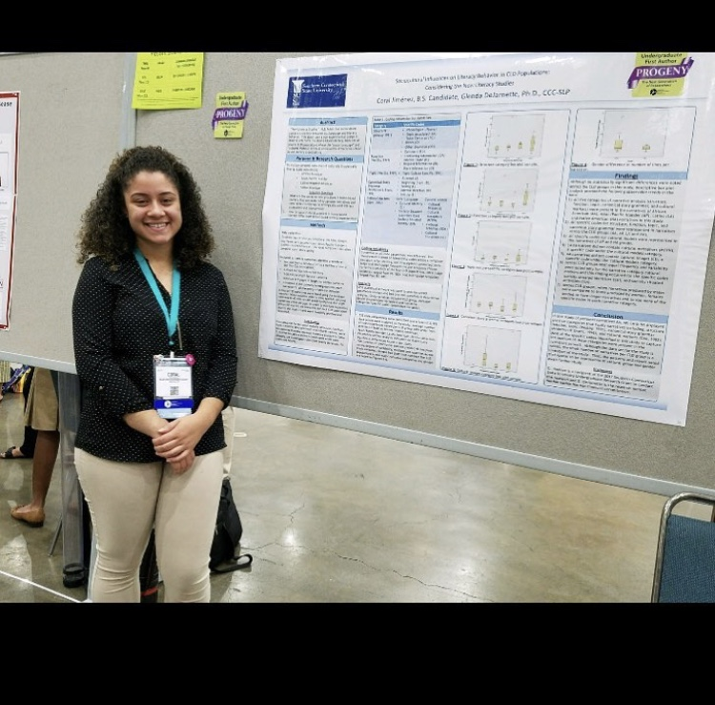
Medical Spanish Program
Coral Jimenez is the first graduate of the minor in Medical Spanish for Health and Human Service professionals, which launched in 2015. She is a recipient of the Undergraduate Research and Creativity Grant and the Dean’s Health and Human Service Award, and has presented her research in the field of Communication Disorders at national conventions. Coral will continue studying at Southern as she works toward her Master’s degree in Communications Disorders. She plans to continue to use Spanish as she has done while working as a Certified Nursing Assistant for the last four years. As President of the Culture Competence Club, she enjoys doing community service and also serves at a women and children’s center, and coordinates fundraising events for orphanages overseas. As part of her minor in Medical Spanish, Coral interned at the SCSU’s Centre for Communication Disorders, where she did important work translating many of the Centre’s forms from English into Spanish.

Slide 17
M.A. in Romance Languages
The year of 2017-18 has been a productive and transitional year for the M.A. in Romance Languages. The two-year program that we started in 2015-16 has brought great success. The cohort of students who joined the program in Fall 2016 are graduating in Spring 2018. Six students, including four students of Spanish, one in French and one in Italian, completed the degree requirements and successfully graduated from the program. Seven more students will continue working with their advisors on the capstone courses and we expect to graduate them in 2018-19. Being one of the two SCSU graduate programs that have had the highest enrollment among all four CSU campuses in the past four years, the M.A. in Romance Languages has grown steadily.
Embracing the challenges and rapid changes in the new era of education, the M.A. in Romance Languages has taken new steps in program renovation. After exploring a variety of options and possibilities, we decided to incorporate an accelerated Master’s program into our current program and the program coordinator has been working closely with the Graduate School on it.

Slide 18
The degree map of the Accelerated Master’s program will also be a great opportunity for the program to consider productive curriculum changes. We expect the new program will make our programs more attractive and better serve our students. The current M.A. coordinator, Dr. Miaowei Weng, finishes her term in 2018-19. Due to her Sabbatical Leave, Dr. Rafael Hernández will start the coordination of the program in Spring 2019. We have confidence that the M.A. in Romance Languages will continue to thrive under new leadership.

Slide 19
World Languages Certification Program
This year has been an exciting year for students in the World Language Teacher Certification program at Southern. With many activities, projects, classes, outreach, and professional development opportunities, there has been no shortage of activity. In the fall, a group of professors and students from the World Languages and Literatures Department attended and presented at the annual Connecticut Council of Language Teachers (CT COLT) Conference at the Radisson Hotel in Cromwell. In the spring of 2018, the program was overwhelmed with pride to have five fantastic students graduate with their BS in Spanish and will now be eligible to seek CT State Certification in secondary Spanish. These excellent students (now soon to be teachers), listed in alphabetical order include: Andrew Catapano, Alexandra Ciucanu, Verónica Egas, Stephanie Sanchez, and Abner Yanes. A huge congratulations again to these students! Our hearts are full for you.
(Right) Dr. Miaowei Weng and Dr. Jesse Gleason representing Southern’s World Language Programs at the 2017 CT COLT Conference

Slide 20
In addition, we were able to celebrate these five students’ completion of an arduous but gratifying semester of student teaching. In this same semester, all of them completed and passed their EdTPA portfolios, a major milestone for all teachers in Connecticut seeking state certification.
We have been active on social media this year, with regular posts on our Facebook Group “SCSU World Language Certification Program” and a new Twitter handle @SCSU World. Check us out on both of these venues, posting pictures and events from the program.
Left to right: Verónica Egas, Andrew Catapano, Dr. Jesse Gleason, and Stephanie Sánchez.

Slide 21
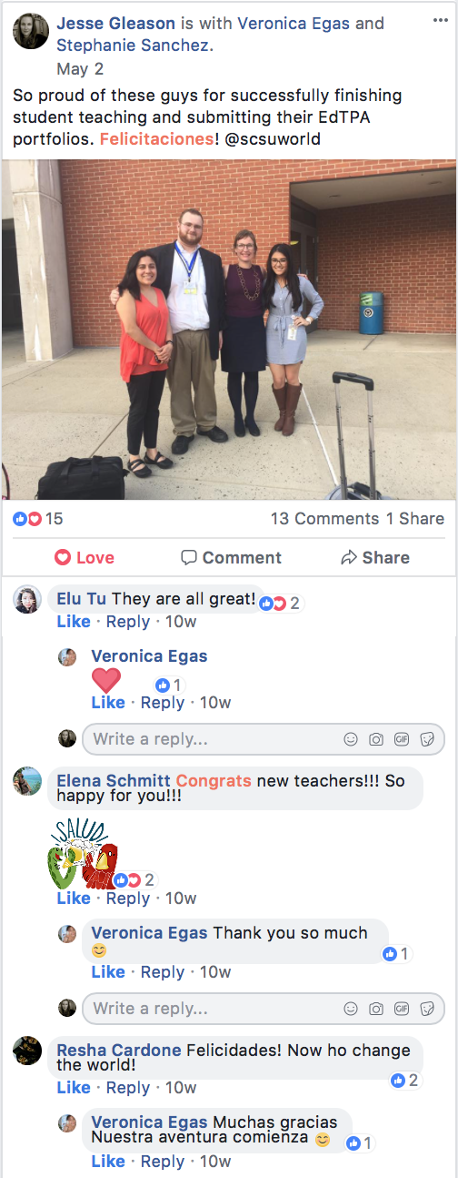
In the spring, the department also celebrated students at our annual end-of-year celebration.
Pictured from left to right: Prof. Luisa Piemontese, Alexandra Ciucanu, and Prof. Jesse Gleason

Slide 22
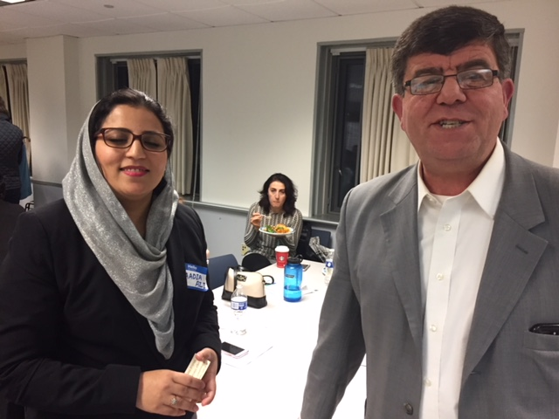
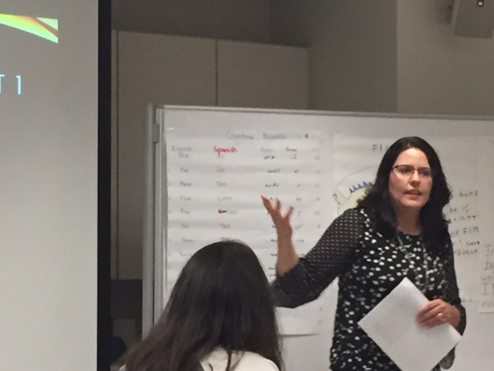
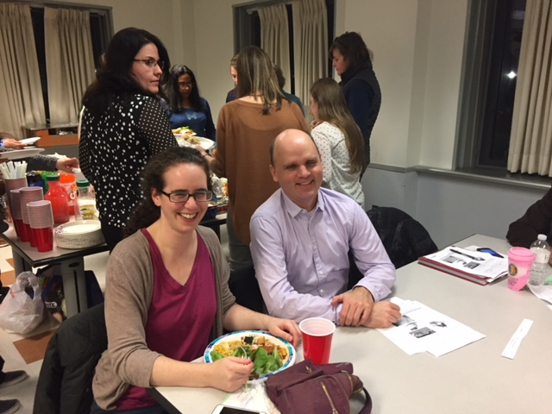
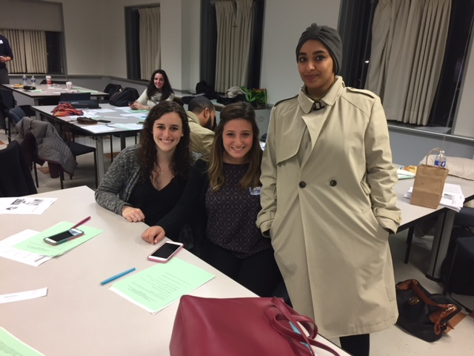
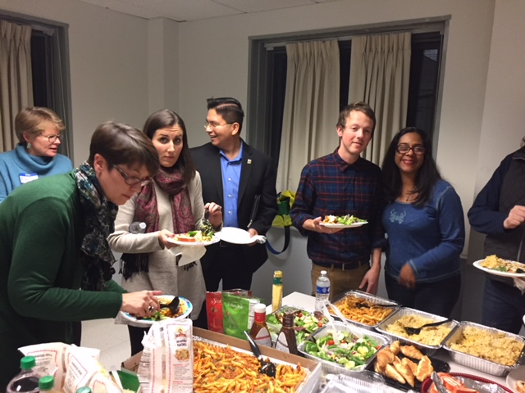
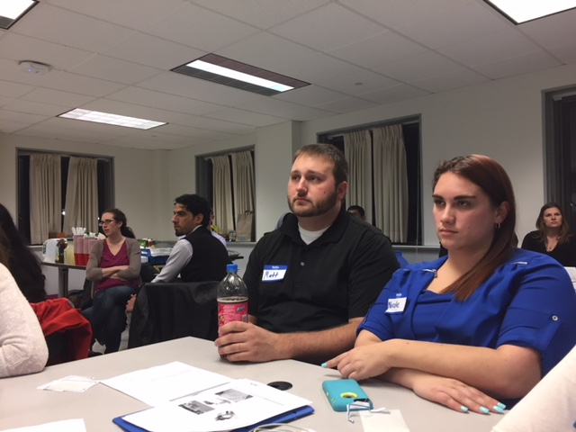
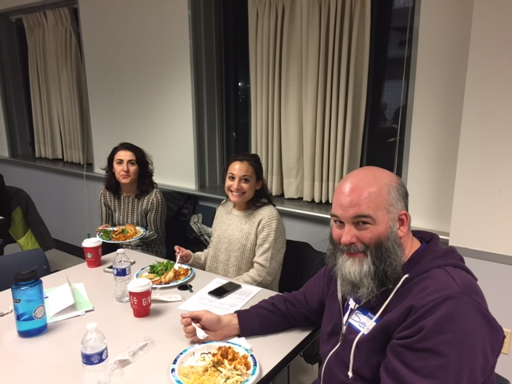
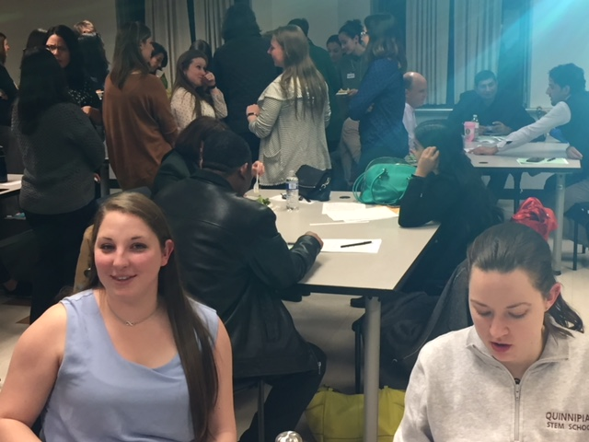
Bilingual/Multicultural Ed & TESOL
We are happy to have had another exciting year for the M.S. in Bilingual/Bicultural Education and TESOL program. We welcomed 25 new graduate students to our program in August, 2017! Our two semi-annual TESOL capstone colloquia in December 2017 and April 2018 were very successful, with friends—old and new—lots of delicious food, learning, and laughs. Twelve of our current graduate students presented their final capstone projects.

Slide 23
We would like to wholeheartedly congratulate our students, who are graduating this academic year: Elizabeth Acosta, Saadia Ali, Laura Barberia, Nicole Cassidy, Ron Coleman, Janelle Gallant, Cindy Madeira, Fabiola Pugliese, Elizabeth Tate, Timothy Traverse, Alyssa Zebrowski. We are VERY proud of all of you! We wish you the best in your endeavors to help all students succeed—and especially English learners of all ages and backgrounds!
We are delighted to share our students’ achievements in this Newsletter! Our graduating student Laura Barberia developed and presented her study on “Culturally Responsive Curriculum for Heritage Speakers at the Elementary Level” at the 2nd Annual Graduate Research and Creative Activity Conference in May 2018 at Southern.
Laura Barberia’s Presentation

Slide 24
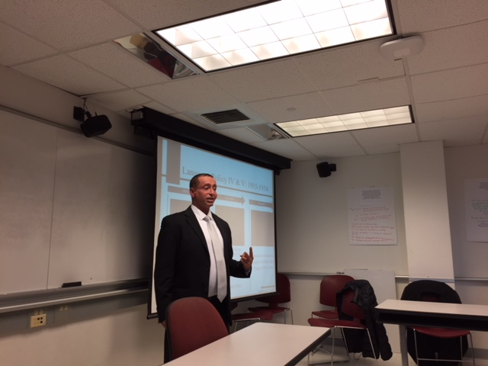
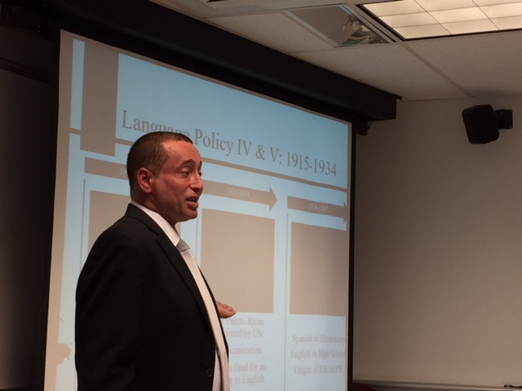
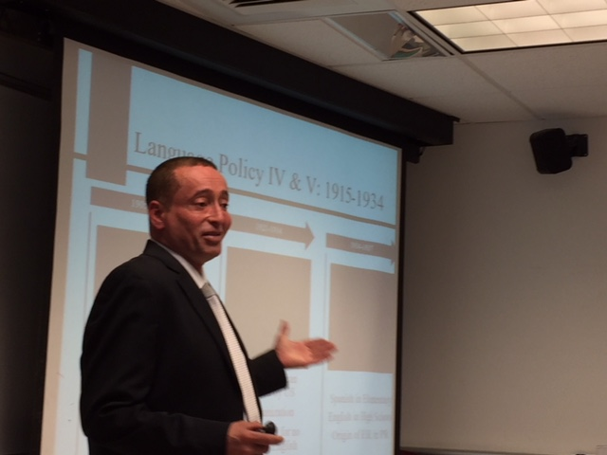
Our current graduate student Sean Otterspoor presented his work "Visual Transcripts: Integrating Technology and Listening Comprehension for ELA, ESL, Sheltered and TESOL Classes" at ConnTESOL conference in October, 2017.
We had several exciting visits from scholars, journalists, artists, and teachers this year! Here are some of the highlights:
A Faculty Development grant in the Spring of 2018 helped us bring to campus one of our colleagues from Universidad del Turabo in Puerto Rico. Dr. Philip Murray Finley presented his work on “Teaching English in Puerto Rico: 120 years of controversy and debate” to our students and faculty from a variety of departments and schools.

Slide 25
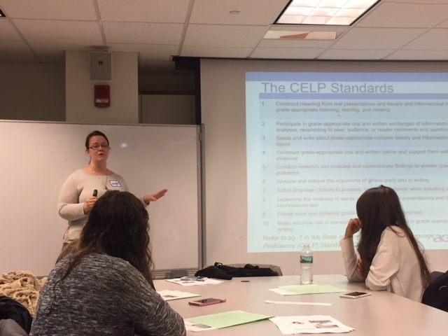
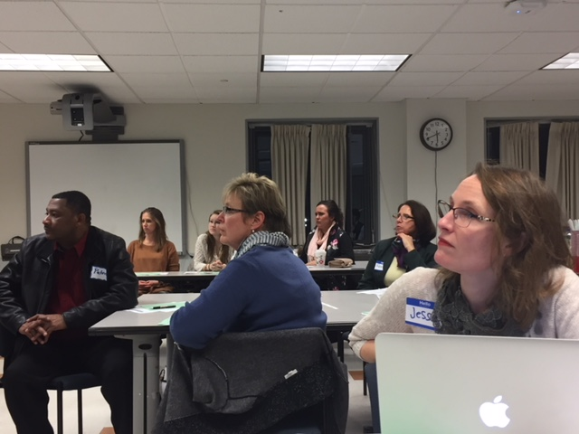
Our alumna Maggie Stevens Lopez came to our graduate colloquium in December of 2017 to discuss the newly adopted Connecticut English Language Proficiency (CELP) Standards with our graduate students. Another alumna Tashi Sanchez-Llaury visited our Immigration class in the Spring of 2018 to talk to the students about experiences of undocumented immigrants and the role of advocacy. CT Mirror’s journalist Jacqueline Rabe Thomas, a winner of two first prizes from the National Education Writers Association, visited our Bilingual Education class in the fall of 2017 to share with the students and faculty her work on bilingual and dual language education in Connecticut and across the nation.

Slide 26
We also had a special visit from Michael Sloan, a Pulitzer Prize winner of 2018, who presented to students his distinguished work on a refugee family from Syria and their new life in the US. His graphic story “Welcome to the New World” can be found and enjoyed on this website: https://www.nytimes.com/interactive/2017/10/26/opinion/sunday/welcome-to-the-new- world.html
Our year ended with a book fair generously hosted by Dr. Lorrie Verplaetse who retired from the program last January and has offered students, faculty, and colleagues from all over New England books from her professional collection!
Our faculty have also been working hard on their creative activity. Dr. Jesse Gleason and Dr. Elena Schmitt have contributed the following studies to the profession:
Gleason, J. & Schmitt, E. (2018). Evaluating teacher tech literacies using an argument-based approach. In S. Link & J. Li (Eds.), Assessment of online education (pp. 116-137). San Marco, TX: CALICO.
Gleason, J. & Schmitt, E. (under review). The Knowledge Framework for building teacher awareness of language in content instruction. In T. Slater (Ed.), Social practices in higher education: A knowledge framework approach to linguistic research and teaching. London, UK: Equinox.
Dr. Gleason and Dr.Schmitt have also co-presented a study on Grammar teaching across paradigms: Harnessing the best of generative and systemic functional approaches promote teacher metalinguistic knowledge in TESOL. The paper was presented at the AAAL Conference in Chicago in March of 2018.
Schmitt, E. (2018). “The Lost Pieces”: Morphological aspects of language attrition. Handbook on Language Attrition. Oxford University Press.
Schmitt, E. & Eilderts, L. (2018). Connected classrooms initiative: Videoconferencing in a TESOL classroom. International Journal of Teaching and Learning, 30(2).

Slide 27
Language Lab
In this year, we are so excited about the language lab has accomplished tremendously on program updates, space transformation, and education. In addition to the lab operation, we proudly have four lab assistants are on the Dean’s list and two of three graduate assistants are admitted to prestigious graduate programs. Our lab director is invited to participate an annual conference host by North America Taiwan Studies Association (NATSA) as one of the Board of Directors.

Slide 28
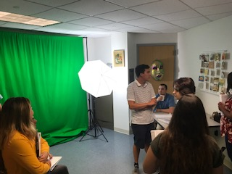
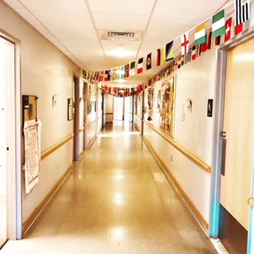
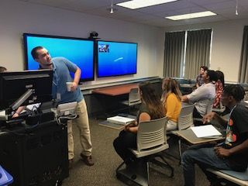
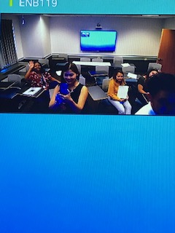
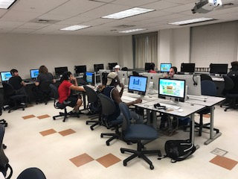
LAB ORGANIZATION: In order to reach the mission statement of the language lab, the lab assistants are assigned to the given program which is coordinated by a senior lab assistant. The language lab is comprised by three programs: education, office management, and Instructional technology. The lab director oversees the progress of these programs to achieve lab assistants’ professional developments.
PROGRAM UPDATE: The theme of linguistic landscape is introduced with three digital programs and one board game. WallaMe is an augment Reality program which can be use to insert hidden message in the picture. It is recommended to use as vocabulary building and short term curriculum activity. Tour builder can be integrated AR and digital literacy.
In the past academic year, there are 2096 students visit and totally spent 6394 hours in our walk-in based open lab. Our resource has supported students and instructors in learning, teaching, assessing. We offered foreign movie DVDs and support department events, including Italian movie series.

Slide 29
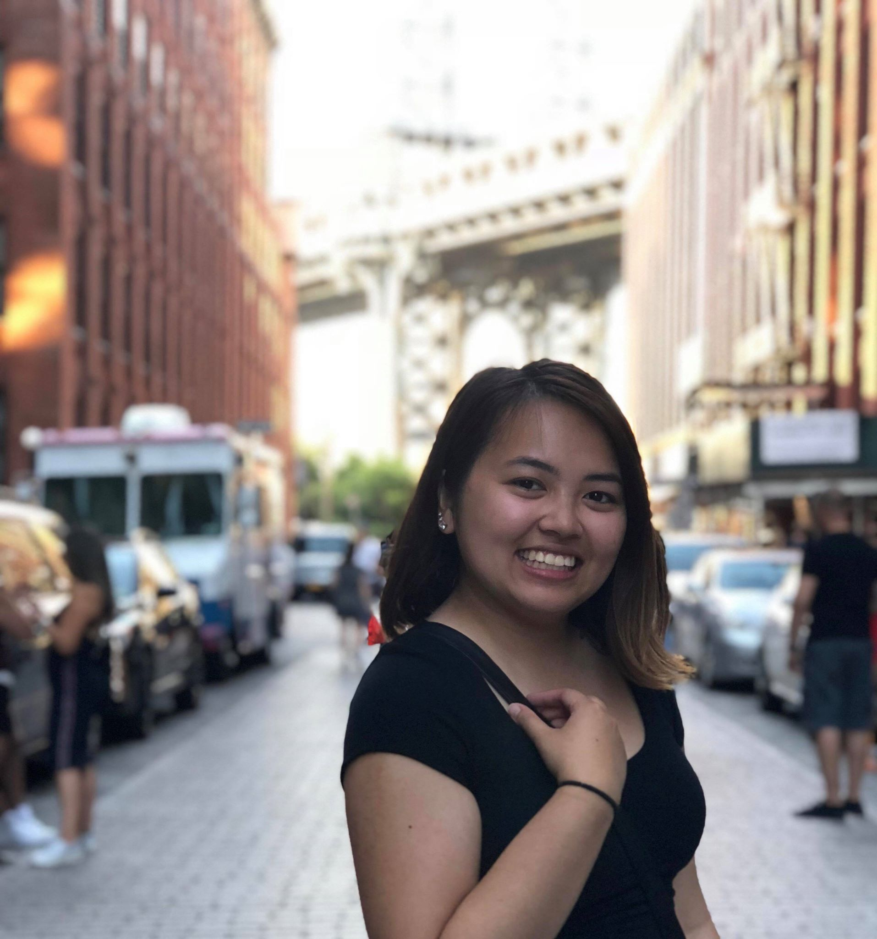
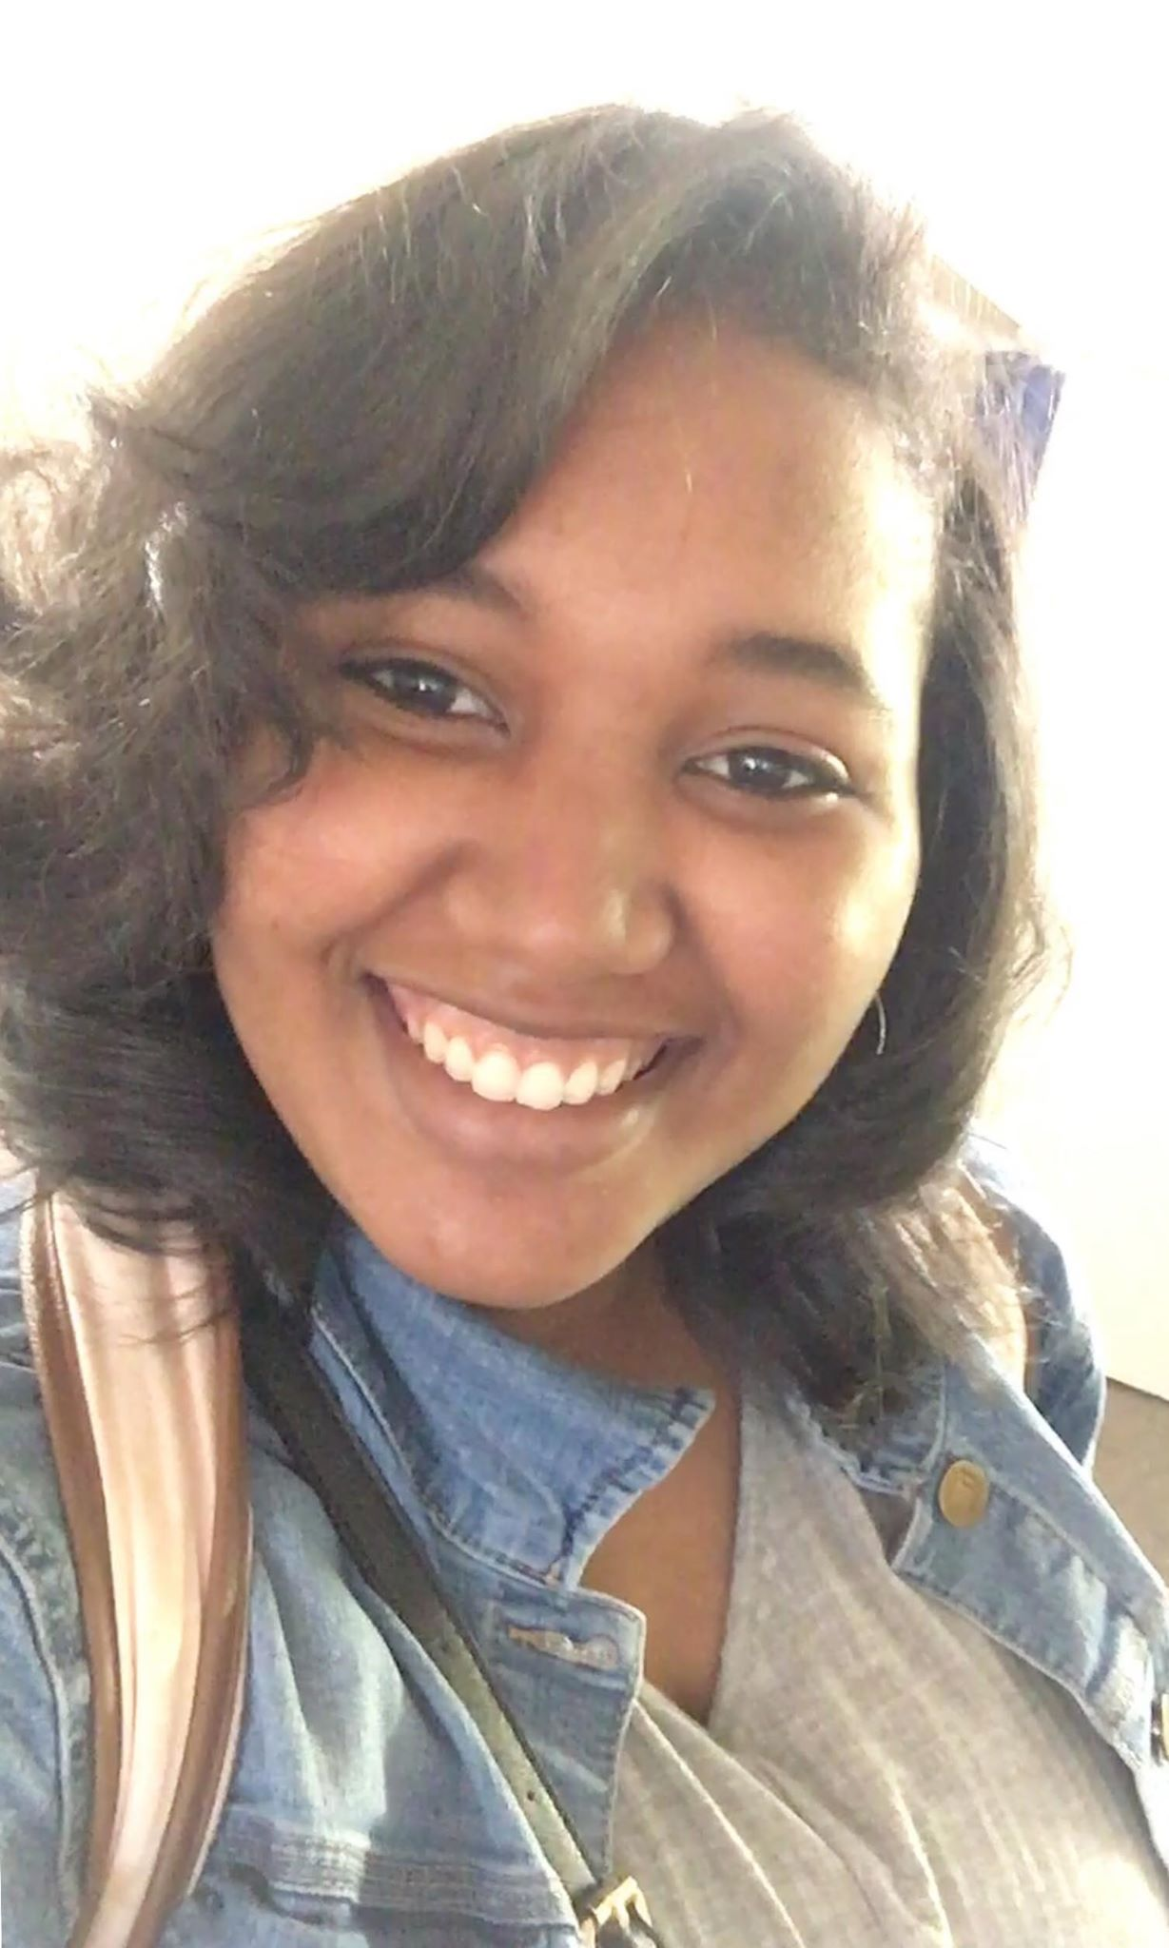
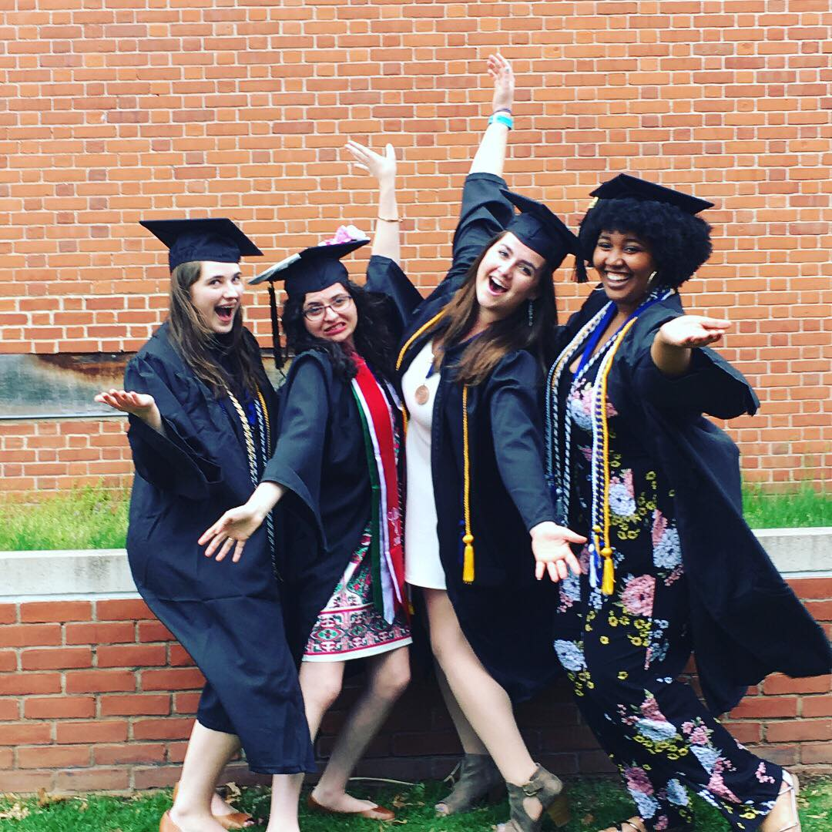
Graduated Lab Assistants
Nick Lemekha was the IT coordinator, he recorded a lot of tutorial videos and shared them on our social media for students to self-learn. He also help Dr. Pelayo with video project. Nick is a video editing expert and has a warm heart.
Our wonderful graduated lab assistant Angelica Gill was the Education Coordinator and received admission to the Master’s Program from New York University of Social Work. There are inumerable good things to say about her. She has been seen as a role model of the entire lab.
We have three lab assistants graduated this year. They’ve contributed valuable intelligence, energy, and time for developing our programs.
Thanh Pham developed a well-designed staff training menu while she was in educational division. Thanh attends a Master’s program of Public Health at Hofstra University.

Slide 30
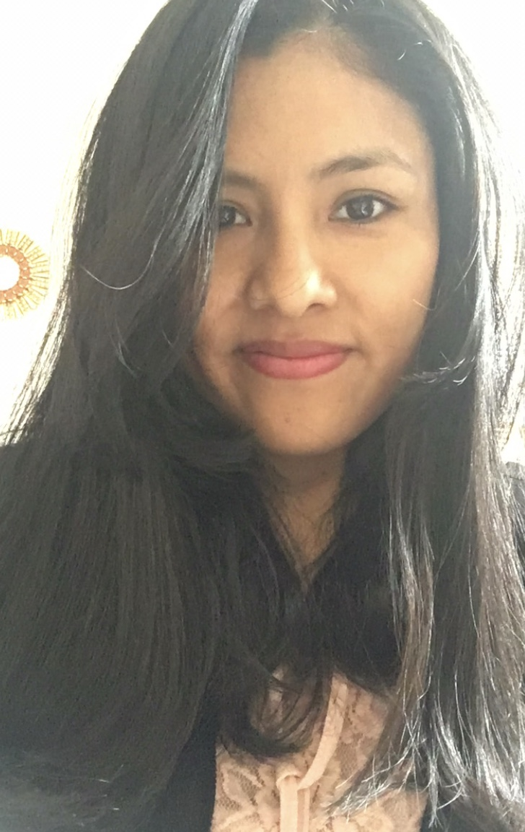
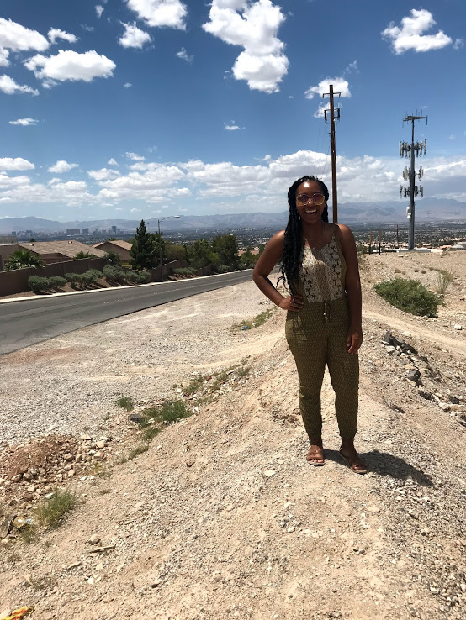
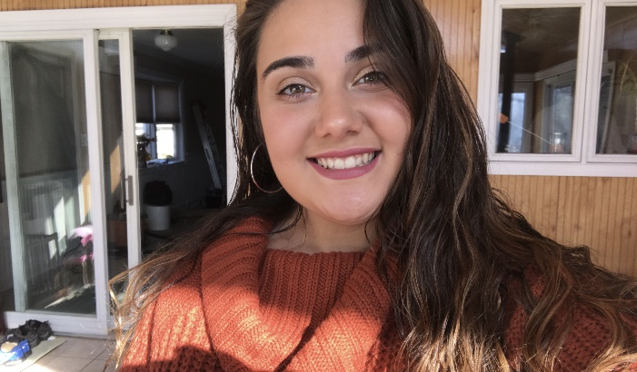
We proudly introduce our current lab assistants who are on the Dean’s list
Weens Simon
Nelly Quito
Sabrina Bahia
Victoria Louis

Slide 31
Lab Director’s Scholarship
PUBLICATIONS
Tu, I. (2018) Emerging Second Language Writing Identity and Complex Dynamic Writing: A Transdisciplinary Perspective. Journal of World Languages, 4: 3,160-181.
Tu, I. (under review) Imagined Mandarin Community through Second Language Writing Practice under a Lens of Complex Dynamic System Theory. International Journal of Applied Linguistics (Received Nov. 15 2017)
Tu, I. Cultivating Self-Directed Learners in Chinese Classroom: A Case Study of Snowball Writing Practice (under review)
MANUSCRIPTS IN PREPARATION
Tu, I. Does the “Best Practices” Help Students’ Self-Directed Learning in Second Language Writing? A Qualitative Study on Relation between Teacher’s Written Responses and Students’ Self-Directed Learning
RESEARCH PROJECTS IN PROGRESS
Tu, I. and Piemontese, L. Will Silent Way Enhance Language Learners’ Self-Directed Learning Ability and Proficiency?
Tu, I. A Comparison Study of Language Learners’ Self-Directed Learning Ability in Response to Paper-based, Digital Text-based, and Video Based Writing Corrective Feedback.
RESEARCH PROJECT IN PREPARATION
Huang, C. and Tu, I. Engaging Young Learners with a Robotic Learning Environment to Promote Literacy.

Slide 32
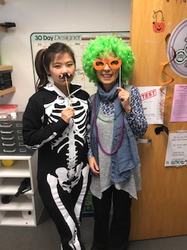
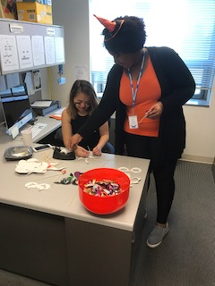
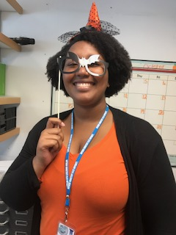
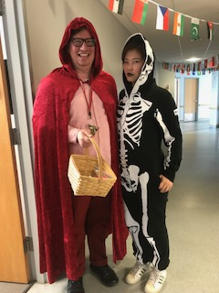
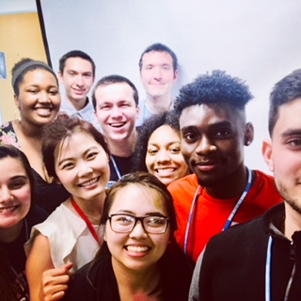
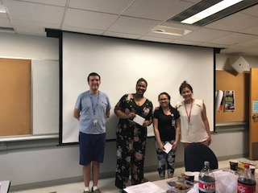
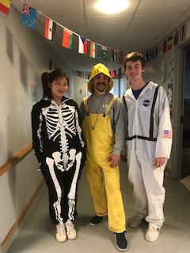
Events we host

