Slide 1
Southern Connecticut State University Core-CT
Time and Labor Employee Self Service:
View Payable Time Summary
Notes:
Instructions:
Thank your class for making the time to attend today’s class.
Next Screen:
Welcome

Slide 2
Overview - View Payable Time
Time & Labor Self Service allows you to view payable time.
View Payable Time’s Status
View each TRC’s total hours summary
Notes:
Next Screen:
Process Flow

Slide 3
Process Flow - View Payable Time
Time needs to be revalidated
Errors?
Employee
Enters
Time
Time Admin
Validates
Time
Manage
Exceptions
Yes
View Payable Time
No
Approve
Time
Time
Ready for
Payroll
Notes:
Next Screen:
Key Points

Slide 4
Key Points - View Payable Time
When viewing payable time, remember the following:
The payable status is current as of the most recent Time Administration process run
Time Administration Process is run
The weekend after payroll ends
First Monday, Tuesday, Wednesday and Thursday after payroll ends
Only time that is clear from exceptions is displayed on the Payable Time pages
Exceptions can be viewed on the Timesheet
Time with a status of “Needs Approval” is not loaded to Payroll
Notes:
Next Screen:
Walk Through

Slide 5
Walk-through and Exercise - View Payable Time
Step-by-Step Demonstration.
First, we will walk-through the process together
Scenario: View Payable Time Summary
Path Reminder: Time and Labor pagelet > Payable Time Summary
Notes:
SCENARIO:
Duncan Donutt entered his 70 hours for the 2/21/13 pay period on his Timesheet yesterday.
Today he wants to see how many hours were processed.
He is going to view that time on the Payable Time Summary page.
He can also view each TRC’s Status on the Payable Time Detail page.
Next Screen:
Navigation

Slide 6
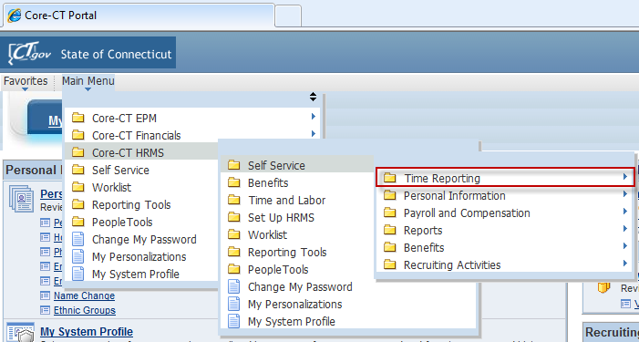
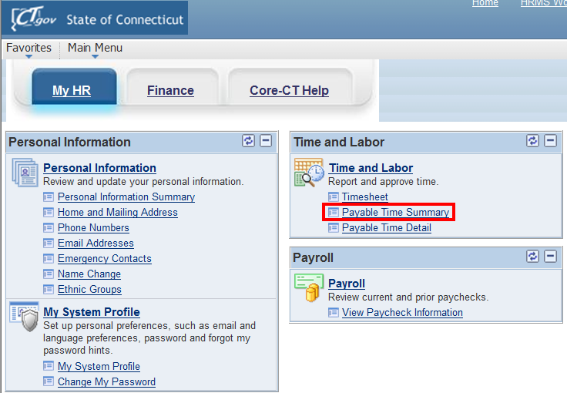
Navigation – Viewing Payable Time Summary
Click on “Payable Time Summary” link on CORE-CT homepage
Notes:
Navigation:
Main Menu > Core-CT HRMS > Self Service > Time Reporting > View Time > Payable Time Summary
Next Screen:
Navigation (cont.)

Slide 7
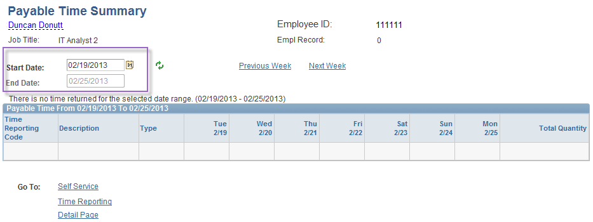
Viewing Payable Time Summary
Payable Time Summary shows 7 days of data
The End Date defaults to today’s date
The Start Date defaults to 7 days prior to the End Date
Notes:
Information:
Payable Time Summary: 7 days at a time.
End Date defaults to today’s date.
Start Date defaults to 7 days before the End Date.
Next Screen:
Payable Time Summary – Start Date Calendar option

Slide 8
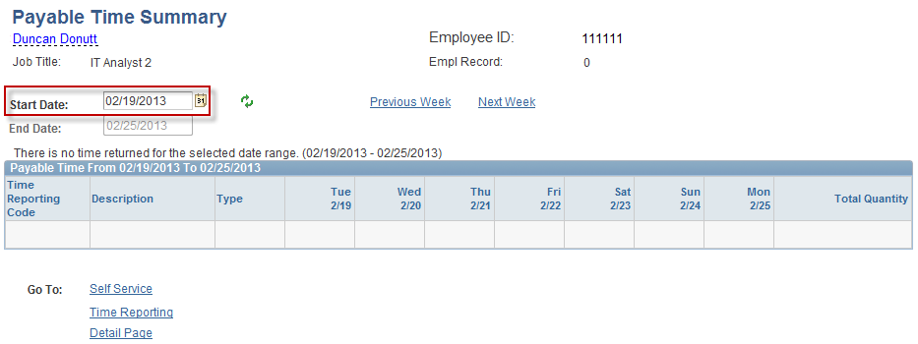
Viewing Payable Time Summary
Use the calendar icon to change the Start Date to the week you are reviewing time for
Notes:
Information:
Update the Start Date to the week you want to view.
Instructions:
Delete the Start Date and enter 2/8/13 or select the Start Date from the Calendar icon
Next Screen:
Payable Time Summary – Refresh

Slide 9
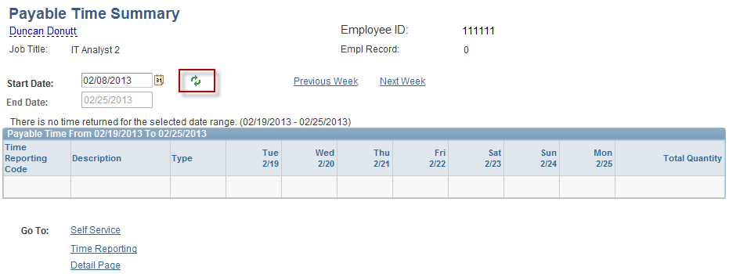
Viewing Payable Time Summary
Click the refresh button to update the End Date
Notes:
Information:
None
Instructions:
Click the Refresh icon
Next Screen:
Payable Time Summary – Verify first week of pay period

Slide 10
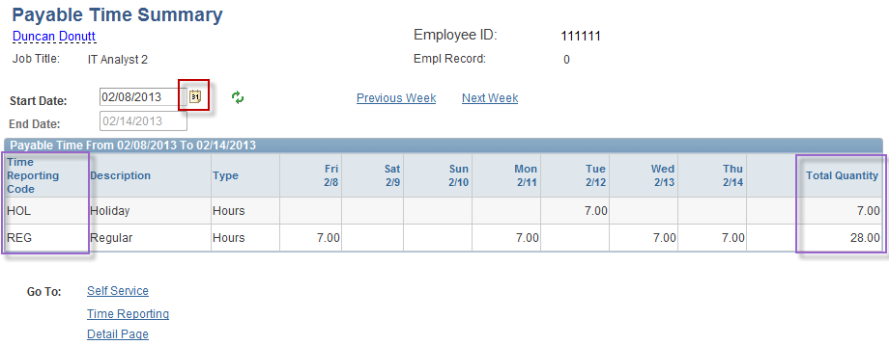
Viewing Payable Time Summary
Page displays Payable Time for the week selected
All TRC’s used are displayed
All hours keyed in the week are displayed individually and totaled.
Notes:
Information:
Payable Time is displayed.
Summary Page: Sums each TRC’s total amount: A. REG = 28.00 B. HOL = 7.00 (Total = 35.00)
Instructions:
1. Click the Calendar icon.
Next Screen:
Payable Time Summary – Calendar icon

Slide 11
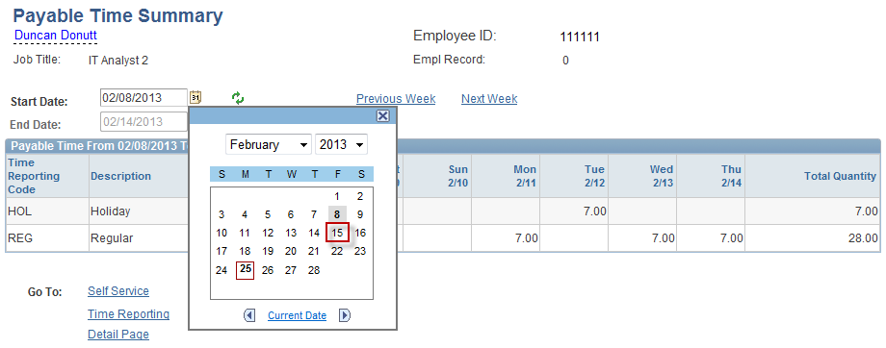
Viewing Payable Time Summary
To view a different week simply click on the calendar link and choose a new Start Date
Notes:
Information:
1. You can select a different month and/or year, as well as the day.
Instructions:
Click 15.
Next Screen:
Payable Time Summary – Get Rows (to refresh updated Start Date)

Slide 12
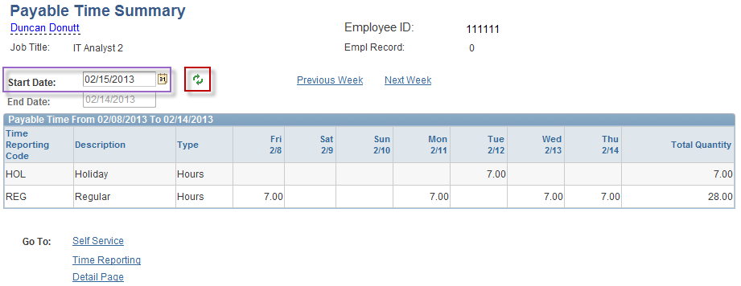
Viewing Payable Time Summary
Click on the Refresh button
Notes:
Information:
Start Date: 2/15/13.
End Date: 2/21/13.
An updated Start Date is not refreshed until you click the Refresh button.
Instructions:
Click the Refresh button.
Next Screen:
Payable Time Summary – Verify second week of pay period

Slide 13
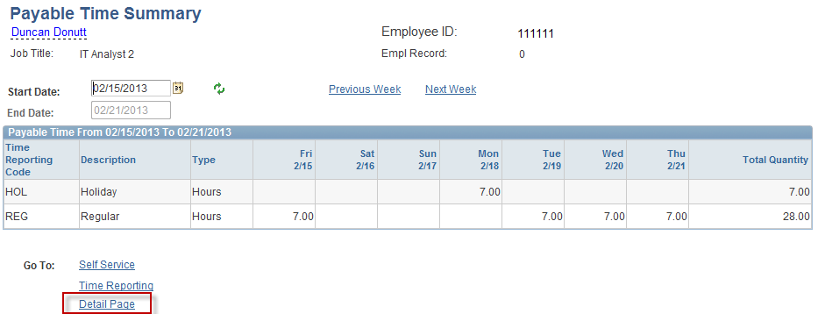
Viewing Payable Time Summary
You can also navigate from week to week by using the “Previous Week” and “Next Week” links
Click on the “Details Page” link to view the times Payable Time Status
Notes:
Information:
Summary Page: Sums each TRC’s total amount: A. REG = 28.00 B. HOL = 7.00 (Total = 35.00)
Details Page will display the Payable Time Status
Instructions:
Click Details Page link.
Next Screen:
Payable Time Details – Verify second week of pay period

Slide 14
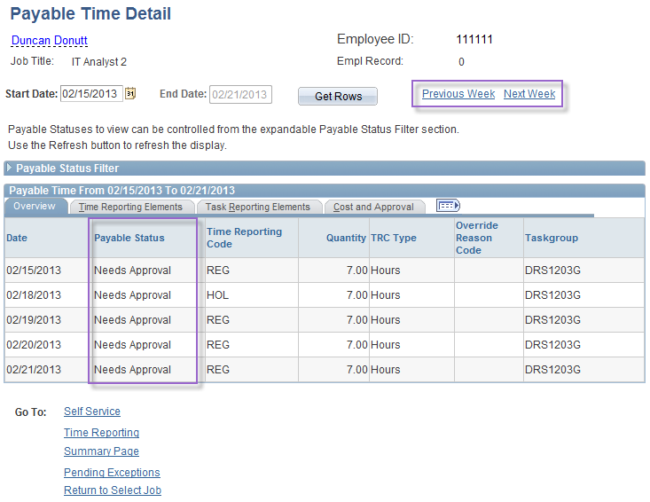
Viewing Payable Time Detail
Navigate from week to week using the “Previous Week” and “ Next Week” links
Page displays the “Payable Status” of the time being viewed
Needs Approval
Approved
Taken – collected by Payroll
Distributed – processed and paid
Notes:
Information:
Status = Needs Approval
View 7 days at a time when linked from the Payable Time Summary page
Use the Previous Week or Next Week to view the status of other weeks.
Status notes: A. Needs Approval: Time Admin has processed the entry as valid but it has not been approved by the Time Approver. B. Approved - Goes to Payroll: The entry has been processed as valid, approved by the Time Approver and will be collected during the next Payroll process. C. Taken – Used by Payroll: The Payroll process successfully collected the entry but the paychecks have not yet been finalized (confirmed). D. Distributed: The entry has been processed by Time Admin, approved by the Time Approver, collected by Payroll and Confirmed. *** This status populates Monday of pay week.
Next Screen:
Overview – Previous Week link

Slide 15
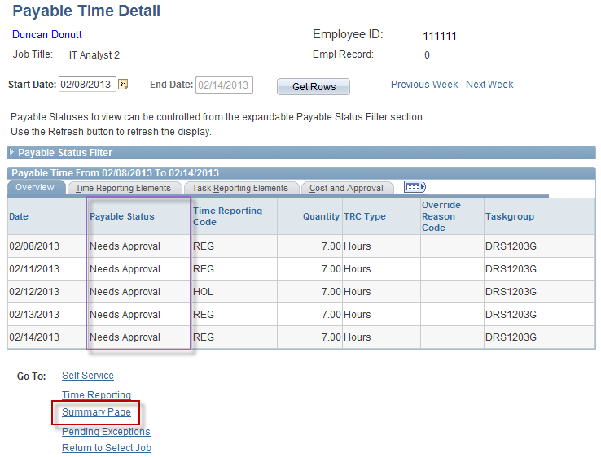
Viewing Payable Time Detail
Click on the “Summary Page” link to return to the Summary Page
Notes:
Information:
Status: Needs Approval.
Will this be sent to Payroll as is? (NO)
Instructions:
Click Summary Page link.
Next Screen:
Overview – 2/14/13 week

Slide 16
Review - Viewing Payable Time
When viewing payable time, remember the following:
The payable status is current as of the most recent Time Administration process run
Only time that is clear from exceptions and has run through the Time Administration process displays on the Payable Time pages
All entered time, including updates, must be validated and approved to be collected by Payroll
Only time with a status of “Approved – Ready for Payroll” is ready to be loaded to Payroll
You can view each TRC’s Payable Time’s Status and total hours summary
Summary is 7 days and Details is 31 days view (unless linked from Summary)
Notes:
Information:
1. Summary = TRC Total for 7 days.
2. Details = TRC Status up to 31 Days (or 7 if linked from Summary Page).
Next Screen:
Knowledge Check

Slide 17
Knowledge Check - Viewing Payable Time
Answer the following questions:
1. When is time populated on the Payable Time pages?
After the Time Administration process runs overnight
2. If a day of time is missing from the Payable Time page, what likely happened?
The time created an exception when the Time Administration process ran.
3. How many days does Payable Time Summary display?
7 days
Notes:
Information:
After the Time Admin process runs.
Task Reporting Elements tab
Up to 31 (7 days when linked from Payable Time Summary page)
7
Next Screen:
Agenda

Slide 18
Questions
Questions?
Payroll Department
Beata Winiarski - Payroll Coordinator - (203) 392-5425
Ken Pereira - Payroll Officer - (203) 392-5427
Kommaly Xayasone – Payroll Clerk- (203) 392-5079
Linda D'Addio - Payroll Clerk - (203) 392-5621
Notes:
Information:
Perform exercises as desired.
Encourage them to ask for assistance if needed.
Instructions:
1. Stroll around room and assist users as needed.
Next Screen:
None – End of presentation

